Slide 1
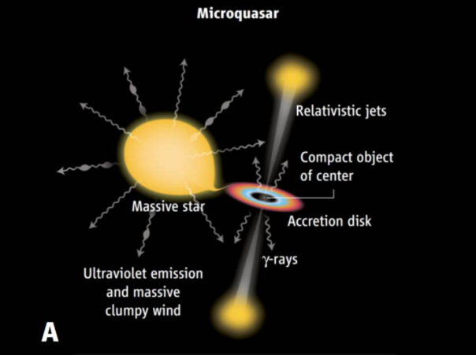
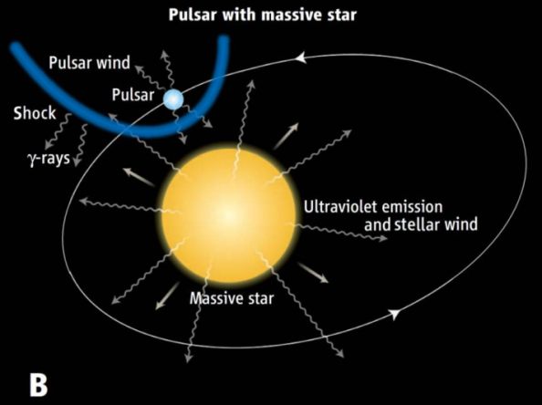
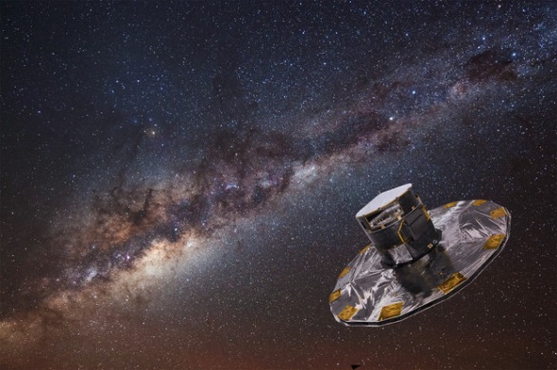
Identification of compact objects in gamma-ray binaries by high-precision astrometry
Gaia
©ESA/ATG
Masaki YAMAGUCHI
Institute of Astronomy, University of Tokyo
Collaborators
T. Yano, N. Gouda (NAOJ)
Variable Galactic Gamma-Ray Sources (IV) @ Rikkyo Univ. July 5 2017

Slide 2
Outline
Introduction
Identification of compact objects by measuring dynamical masses
Method
Confidence levels as a function of binary parameters
Results
For LS 5039, LS I +61 303, 1FGL J1018.6-5856, HESS J0632+057
Summary

Slide 3
NS or BH?
Galactic gamma-ray binaries
Object | Distance(kpc) | period(days) | Stellar mass (M_{o}) | Consists of …
LS 5039 | 2.5 | 3.9 | 23 | O6.5+??
1FGL J1018.6-5856 | 5 | 16.6 | 37 | O6 + ??
LSI +61 303 | 1.9 | 26.5 | 13 | B0e + ??
HESS J0632+057 | 1.4 | 321 | 16 | B0e + ??
PSR B1259-63 | 2.3 | 1237 | 31 | O9.5e + NS
BH scenario
Two emission scenarios are proposed
(A) Accretion & Jet (BH is favored)
(B) Wind collision (NS is favored)
But which scenario is realized is under discussion
The compact object is not identified
Mirabel 2012
NS scenario
(Mirabel 2012, Sci., 335,175)

Slide 4
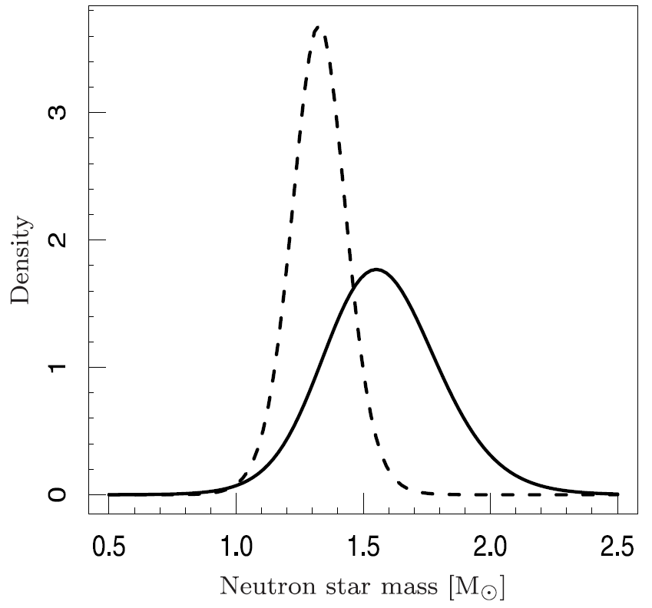
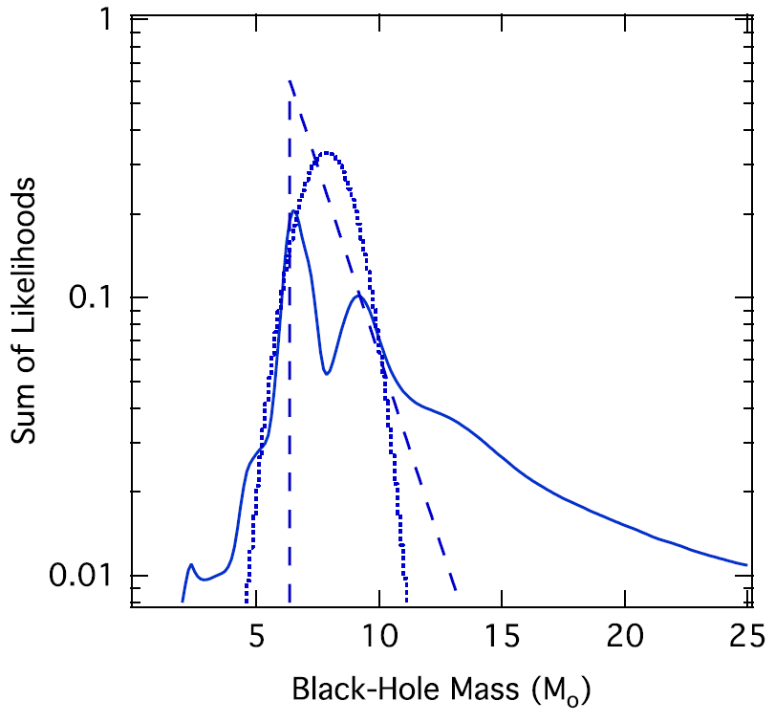
Identification by mass measurement
Mass distributions of NS and BH
We can set the boundary mass M_{bou} at 2.5M
Neutron star
Black hole
Kiziltan et al. 2013, ApJ, 778, 66
Ozel et al. 2010, 725, 1918

Slide 5
Dynamical mass of a compact object
M_{c}=M_{c}(M*,P_{orb},a*,D): mass of compact object
High accuracy measurements of M*,P_{orb},a*,D enable us to accurately estimate of M_{c}
a* and D are obtained by astrometric observations
(a*: semi-major axis of the companion in unit of radian)

Slide 6
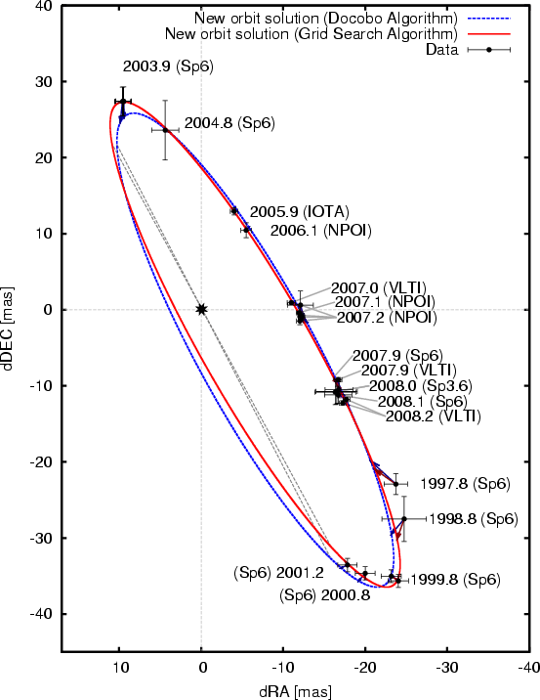
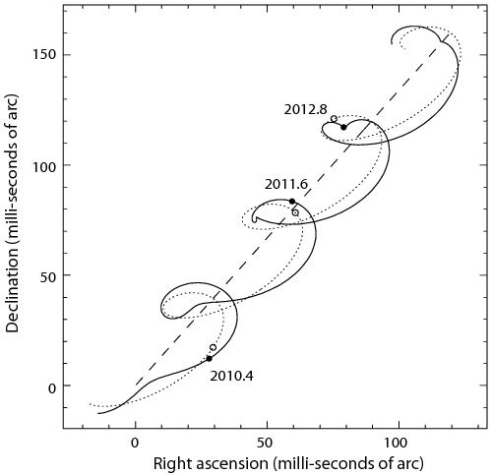
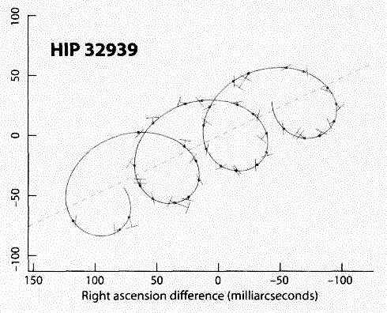
Astrometry for a star in a binary
The binary motion can affect trajectories of stars due to its finite size of orbit
Kraus et al. 2009, A&A, 497, 195
http://inspirehep.net/record/1185740/plots
http://spiff.rit.edu/classes/phys230/
lectures/mass/mass.html
How accurately can we identify the compact
object in gamma-ray binaries?
stellar orbit
(projected)
Stellar motion on
the celestial sphere
Helical motion
Distance D
(parallax π)
Semi-major axis a*

Slide 7
Method (1): Precision of M_{c}
From the formula of the error propagation
Main contribution is the latter two terms
σ_{a} ~ σ_{π} and σ_{D}/D = σ_{π}/π (<- π∝1/D)
σ_{Mc} is a function of M_{c}, σ_{π}, and object parameters (M*, σ_{M*}, P_{orb}, σ_{P}, D)
<- a* is a function of M_{c}, P_{orb}, D, M*

Slide 8
Method (2): C. L. of the identification
M_{c}, σ_{Mc}, M_{bou} (=2.5M) -> false probability (FP)
Object, M_{c}, σ_{π} -> confidence level (CL: 1-FP)
σ_{π}= 1,10,100 μas (=10⁻⁶ arcsec)
PDF
BH case
M_{bou}
σ_{Mc}
Mass
False Prob.
Mc

Slide 9
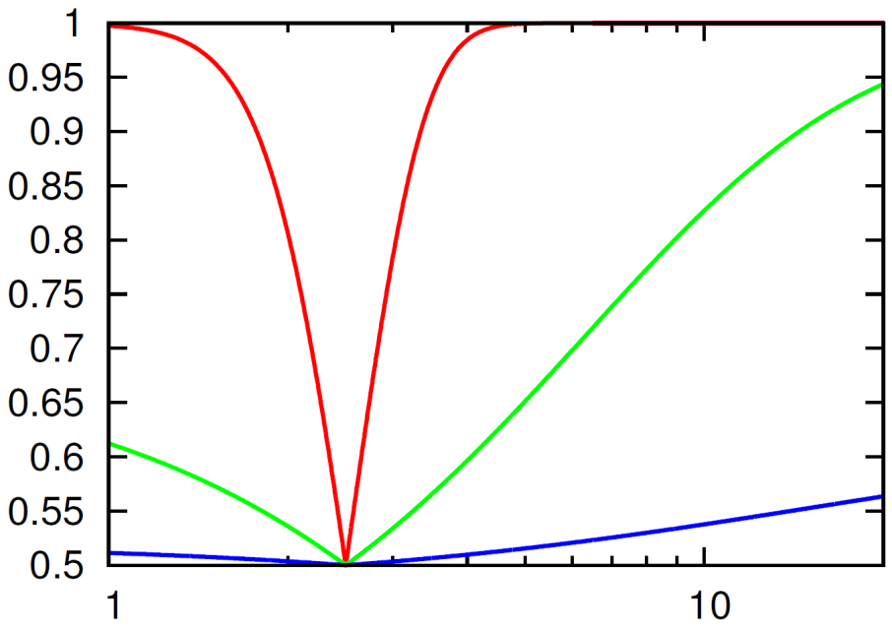
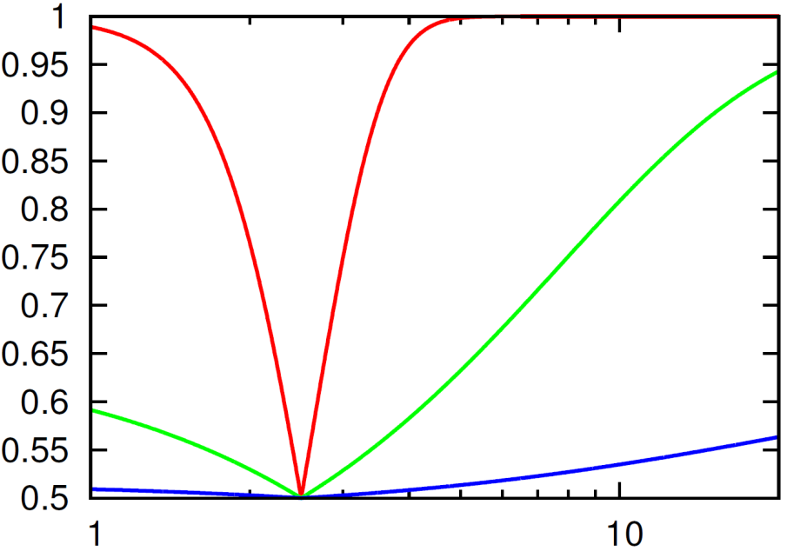
Results: LS 5039, J1018
NS or BH is identified with a 1-μas precision
Heavy BH (>10M) is identified with a 10-μas precision
LS 5039
1FGL J1018
1μas
1μas
10μas
10μas
Confidence level
100μas
100μas
Mc (M)
Mc (M)
(Shaded areas are the region where few objects are expected)

Slide 10
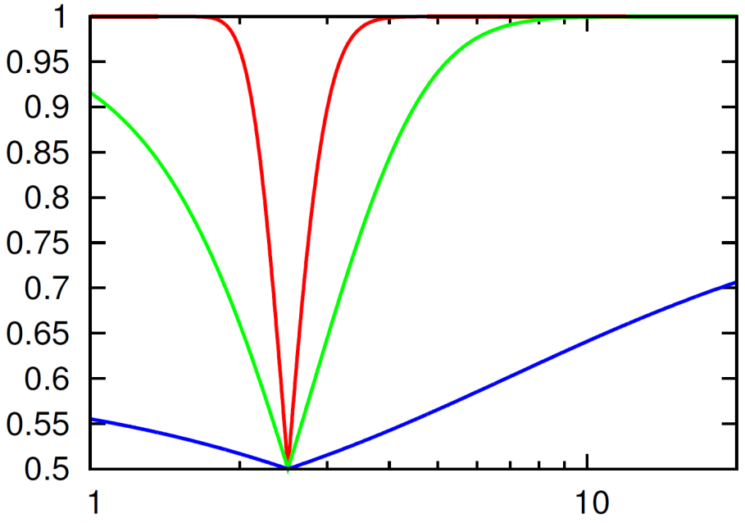
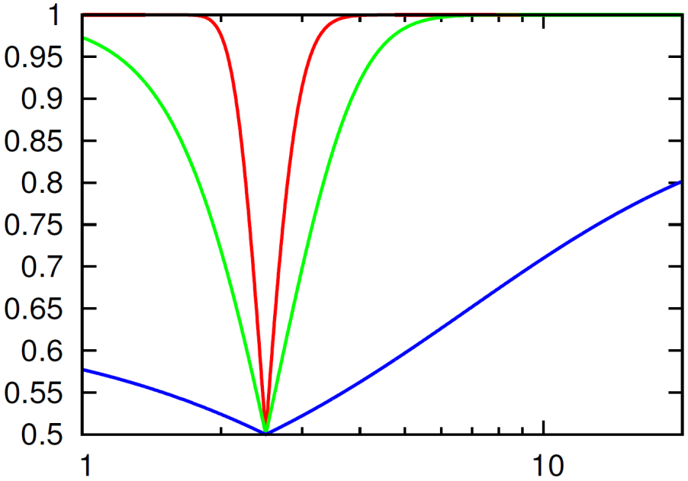
Results: LSI+61 303, HESS J0632+057
Certainly confirmed with 1-μas precision
If BH or normal NS, it is identified with 10-μas precision
LSI+61 303
HESS J0632
1μas
1μas
10μas
10μas
C.L.
100μas
100μas
Mc (M)
Mc (M)

Slide 11
High-precision astrometry
In the near future, high-precision astrometry will be realized
Astrometric precision of Gaia is 0.007 mas !
Small-JASMINE is ~0.01 mas
We can expect that BH or normal NS will be identified for LSI+61 303 and HESS J0632+057
Gaia (2013)
©ESA/ATG
(2020s?)
©NAOJ
Japan Astrometry Satellite
Mission for INfrared Exploration

Slide 12
Summary
Astrometric observations enable us to identify the compact object in gamma-ray binaries
We calculate the confidence level as a function of M_{c} and σ_{π} for gamma-ray binaries
LSI+61 303 and HESS J0632+057 is promising systems for the identification of the compact object by Gaia

Slide 13
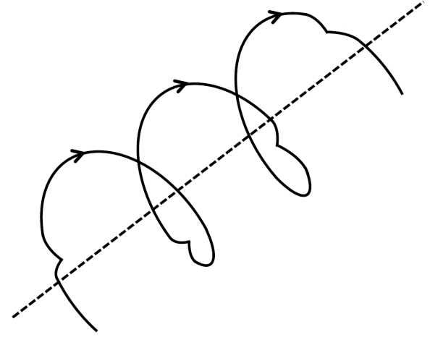
Astrometry for X-ray/gamma-ray binaries
Celestial sphere
Optical star
Compact
object
All orbital elements
a = … ω = …
e = … Ω = …
i = … P = …
Mass of the compact object
+
High precision
White dwarf?
Neutron star?
Black hole?
Primary mass, distance

Slide 14
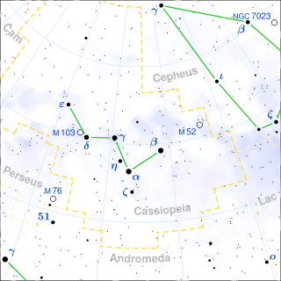
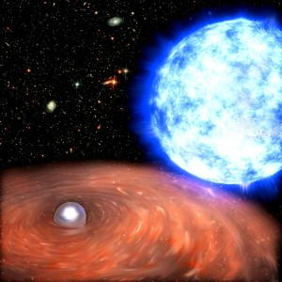
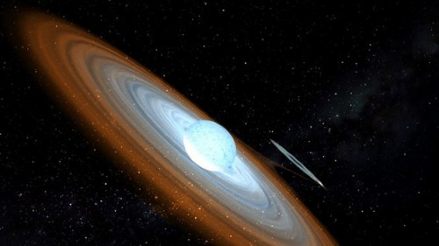
WD or NS? : γ Cas (HMXB)
Object | Distance(kpc) | period(days) | Stellar mass (M_{o}) | Consists of …
γ Cas | 0.17 | 204 | 19 | Be + ??
Wikipedia
X-ray source associated with a Be star
Shows peculiar behaviors, different from usual X-ray binaries:
e.g., very low luminosity: L_{x}~10³²⁻³³erg/s
Candidate scenarios for explaining this X-ray:
(1) Be-WD (or NS) (1) (2)
e.g., Lopes de Oliveira et al. 2007
(2) single Be
e.g., Robinson et al. 2002
The compact object is not identified; WD or NS
Be star
X-ray
WDorNS
X-ray
Be star

Slide 15
Mass precision of X-ray/gamma-ray binaries
The relation between the precision of mass σ_{m} and that of SMA σ_{a}
(~10μas for
Gaia or SJ)
↑distance
Object | Distance(kpc) | period(days) | Stellar mass (M_{o}) | Consists of … | Mass precision (M_{o})
γ Cas | 0.17 | 204 | 19 | Be + ?? | 0.03
LS 5039 | 2.5 | 3.9 | 23 | O6.5+?? | 6
1FGL J1018.6-5856 | 5 | 16 | 37 | O6 + ?? | 6
LSI +61 303 | 1.9 | 26 | 13 | B0e + ?? | 1
HESS J0632+057 | 1.4 | 320 | 16 | B0e + ?? | 0.5
γ Cas: high enough to identify the compact object (WD or NS)
Latter two gamma-ray binaries: high enough to identify the compact object (NS or BH)

