Slide 1
First* Sharable 360° video of an
astrophysical simulation!
Android: QR code →
YouTube app
Other smartphones: Open
YouTube App → Search
“Christopher Russell
astronomy”
my icon:
Laptop:
tinyurl.com/cmpr360video
Smartphone and Laptop:
Choose video “Galactic Center
Column Density – high
frequency, 30 fps”
*Please let me know if others
have done this, too.
Note: This slide was on display during the coffee break, which was right before my talk.

Slide 2
Dynamically modeling non-γ-ray observables of γ-ray-emitting binaries: η Carinae and PSR B1259
Christopher M. P. Russell
NASA
Goddard Space Flight Center
Kenji Hamaguchi NASA/GSFC & UMBC
Atsuo Okazaki Hokkai-Gakuen University
Variable Galactic Gamma-ray Sources IV July 6, 2017

Slide 3
360° video of PSR B1259 containing
Be disk, Be wind, & pulsar wind
Android: QR code →
YouTube app
Other smartphones: Open
YouTube App → Search
“Christopher Russell
astronomy”
my icon:
Laptop:
tinyurl.com/cmpr360video
Smartphone and Laptop:
Choose video “PSR B1259 viewed from the Be star”

Slide 4
Outline
η Carinae
Extensive hydrodynamic modeling
Synthesize X-ray observables – thermal
Subtract thermal component to get non-thermal component
PSR B1259
Hydrodynamic modeling around periastron
Be disk & wind
Pulsar wind
Synthesize pulsar dispersion measure

Slide 5
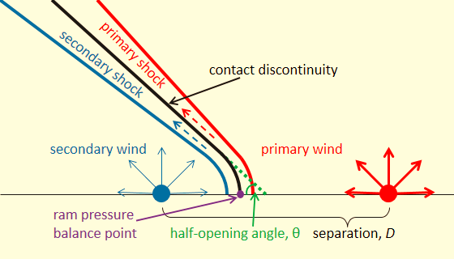
Colliding Winds
winds collide in binary system
1000 km/s → 10M K → 1 keV
KE → heat → X-rays

Slide 6
Lots of Parameters
Hydrodynamic models depend on many stellar, wind, & orbital parameters
Good news: can test many parameters
Bad news: have to know many parameters
or run many models
Russell+16

Slide 7
Hydrodynamics
Smoothed Particle Hydrodynamics
Lagrangian → inherently adaptive with respect to ρ
Code History
Initial development: Benz90, Bate+95
First CWB (η Car): Okazaki+08
Wind acceleration, radiative cooling: Russell13, Madura+13, Russell+16
Stars orbit while continually injecting particles (mass elements) into simulation domain to model stellar winds

Slide 8
X-ray Radiative Transfer
Hydro yields ρ & T
Solve formal solution of radiative transfer
emissivity j_{E} = n_{e}n_{i}Λ_{E}(T) where Λ_{E}(T) is from APEC models (Smith+01) using XSpec (Arnaud96)
wind opacity κ_{E} from windtabs (Leutenegger+10)
ISM opacity κ_{E,ISM} from TBabs (Wilms+00)
visualization program Splash (Price07) is the basis
Fold X-ray flux through telescope response function → compare directly with observations

Slide 10
ω
θ

Slide 11
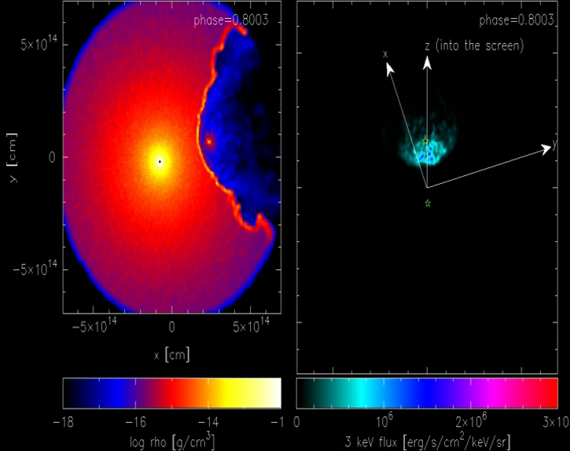
ω
θ

Slide 12
ω
θ

Slide 13
ω
θ

Slide 14
ω
θ

Slide 15
ω
θ

Slide 16
ω
θ

Slide 17
ω
θ

Slide 18
ω
θ

Slide 19
ω
θ

Slide 20
Earth
i
ω
θ

Slide 21
ω
θ

Slide 22
ω
θ

Slide 23
ω
θ

Slide 24
ω
θ

Slide 25
ω
θ

Slide 26
ω
θ

Slide 27
ω
θ

Slide 28
ω
θ

Slide 29
ω
θ

Slide 30
ω
θ

Slide 31
Earth
i
ω
θ

Slide 32
Earth
i
ω
θ
θ ~ 25°, ω ~ 245°
i ~ 135°

Slide 34
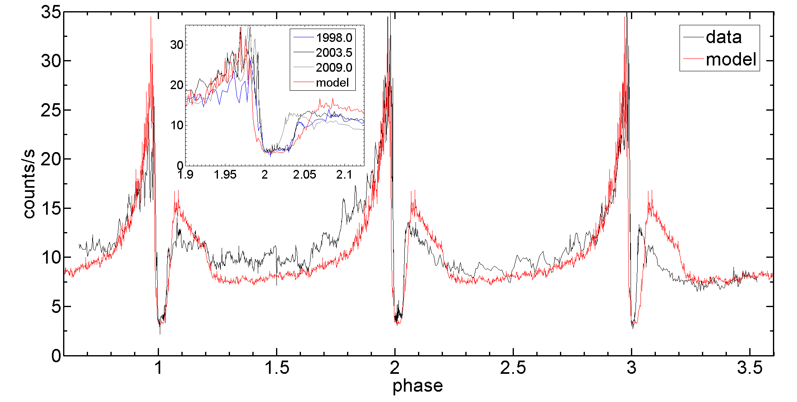
2-10 keV RXTE Light Curve

Slide 35
ρ T
100ax100a
v
Russell+16

Slide 36
X-ray Spectrum at periastron
Compute X-ray spectrum from r<100a region
Model bounds X-ray observations (subject to uncertainty in coupling of primary radiation to secondary wind)
Good handle on thermal X-ray emission
Chandra spectrum
data: Hamaguchi+07,14
Russell+16

Slide 37
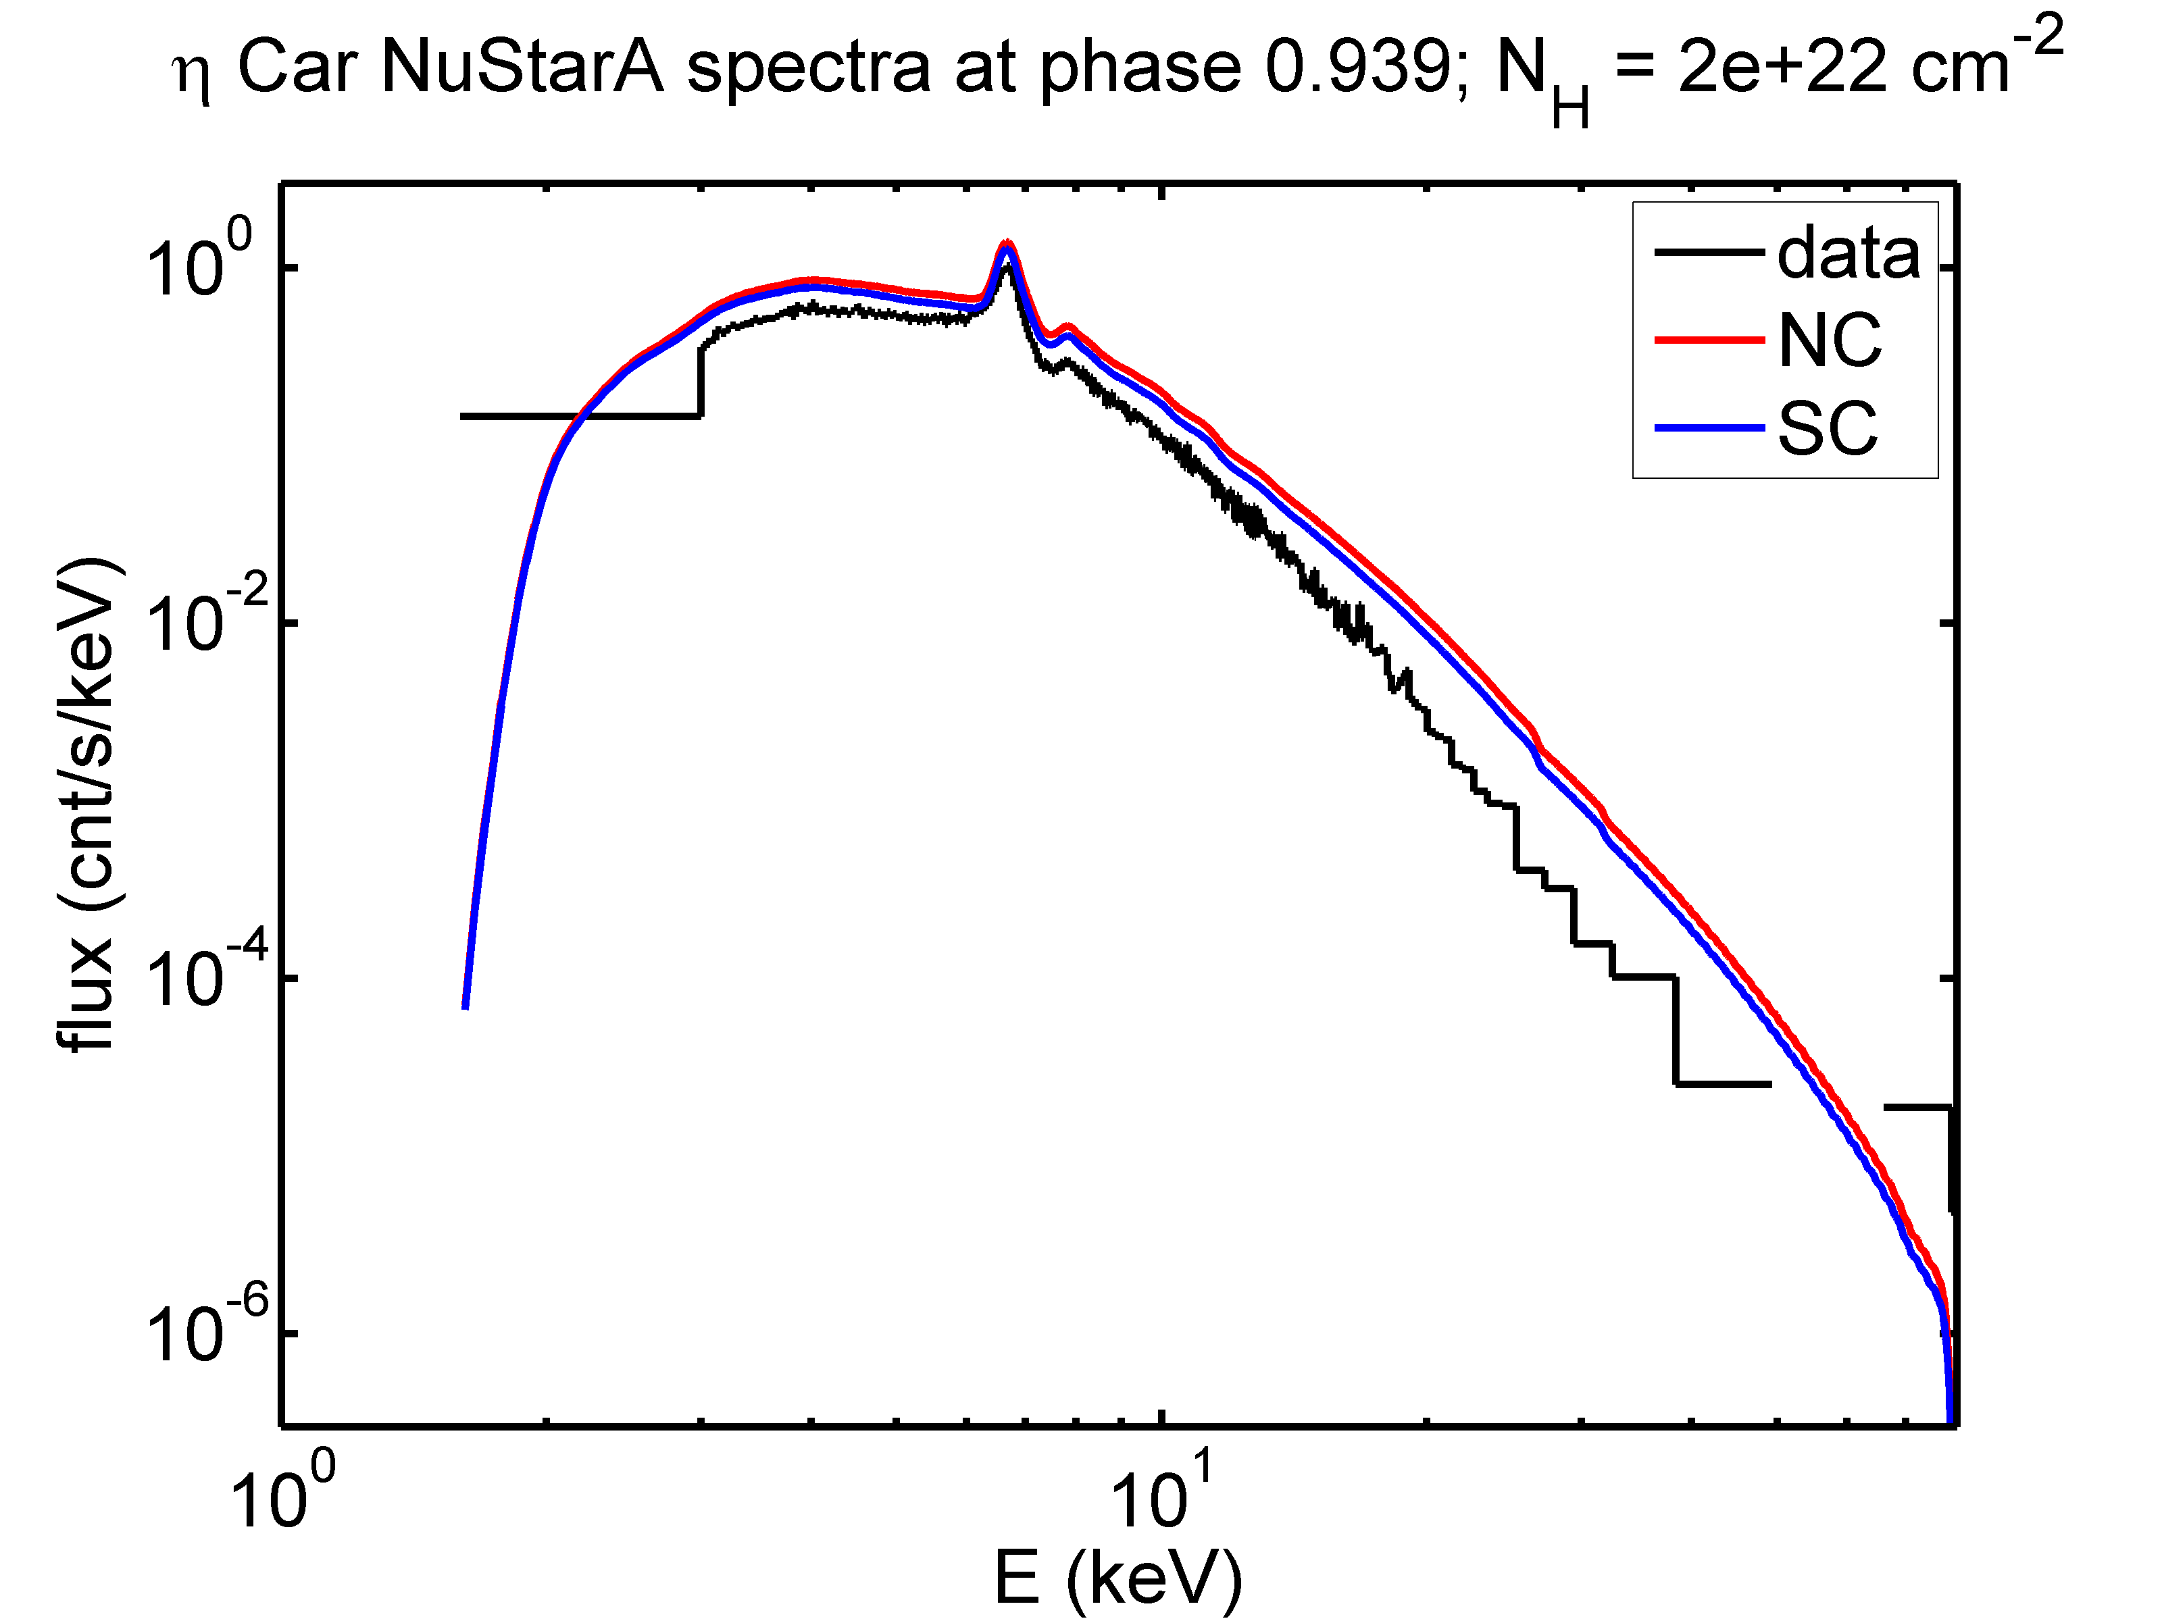
NuStar spectra – beyond 10 keV

Slide 38
NuStar spectra – beyond 10 keV
More detailed comparison due to higher energy range
Model slope slightly too flat → need slight reduction in wind velocity of secondary

Slide 39
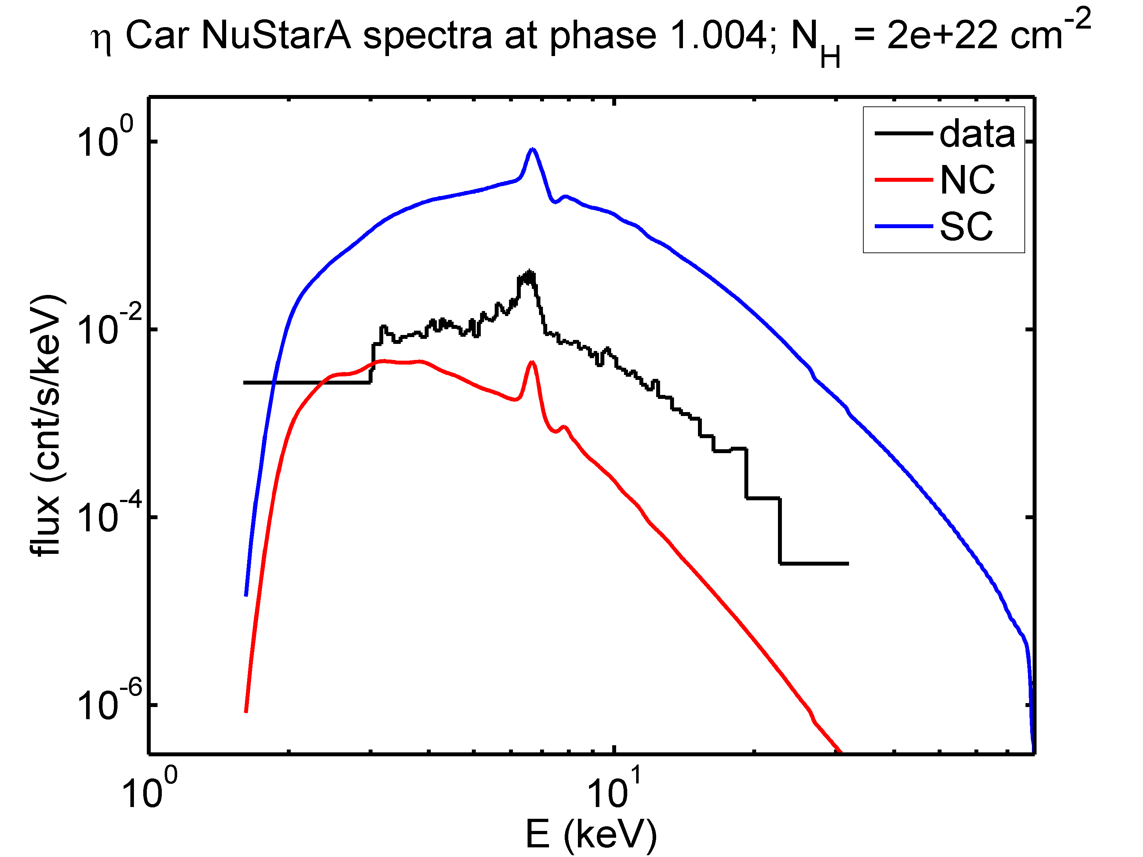
NuStar spectra – beyond 10 keV

Slide 40
Non-thermal X-rays of η Car
Good handle on thermal X-ray emission
→ good handle on stellar, wind & orbital parameters
Initial comparison shows X-ray emission well-fit by thermal model at these two phases – pre-periastron & ~periastron
Future work: compare at other phases, where non-thermal detection is more promising
Detailed hydro + radiative transfer is better than simple XSpec fitting
Subtract off thermal component to get better estimate of non-thermal emission

Slide 41
PSR B1259
Be wind + Be disk + pulsar wind
Use SPH since can handle disks
Non-relativistic code, though, so give pulsar wind same momentum but lower speed
Will not change location of shock between the winds, wind/disk
Variety of parameters explored
Most notable: Be-disk density & Be-wind Mdot

Slide 42
low disk density,
ρ₀=1e-10 g/cm³
high disk density
ρ₀=1e-9 g/cm³

Slide 43
low disk density,
ρ₀=1e-10 g/cm³
high disk density
ρ₀=1e-9 g/cm³

Slide 44
ρ in orbital plane
low disk density,
ρ₀=1e-10 g/cm³
high disk density
ρ₀=1e-9 g/cm³
column density
Takata+12,
Okazaki+ in prep

Slide 45
PSR B1259-63 Observable: PDM
Pulsar Dispersion Measure
Column density of free electrons to pulsar
Tests ionization state of wind and disk
Note: neglecting ISM contribution in this work
Tests Be wind Mdot & Be disk density
Tests orientation of observer related to binary system: inclination & argument of periapsis

Slide 46
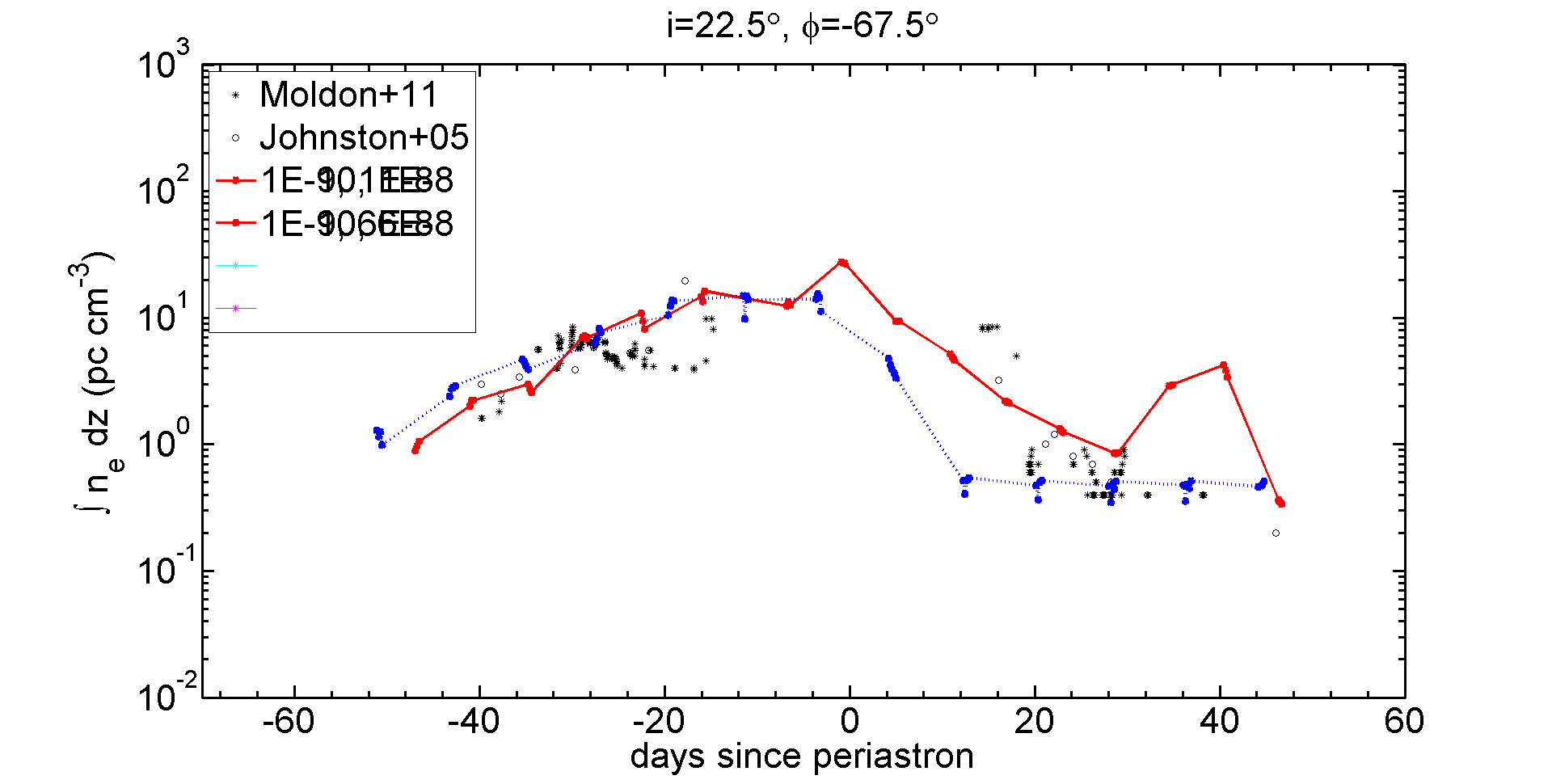
PSR B1259-63: PDM
67°, i=22°
Solid: Be wind ionized Dashed: Be wind & disk ionized

Slide 47
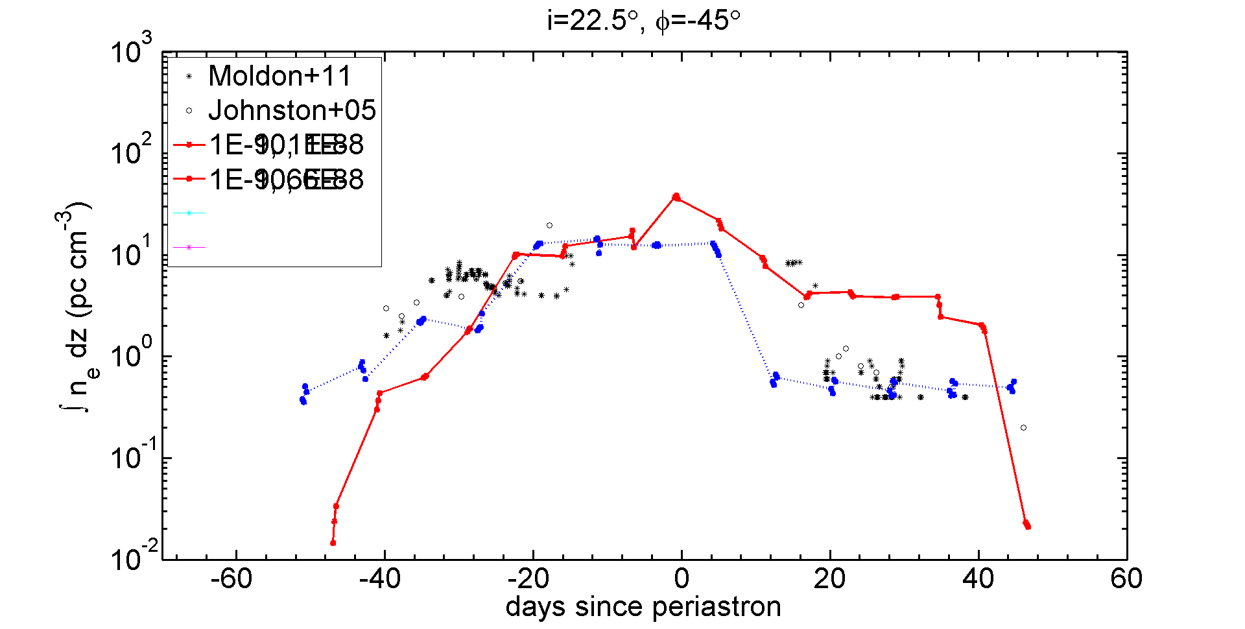
PSR B1259-63: PDM
45°, i=22°
Solid: Be wind ionized Dashed: Be wind & disk ionized

Slide 48
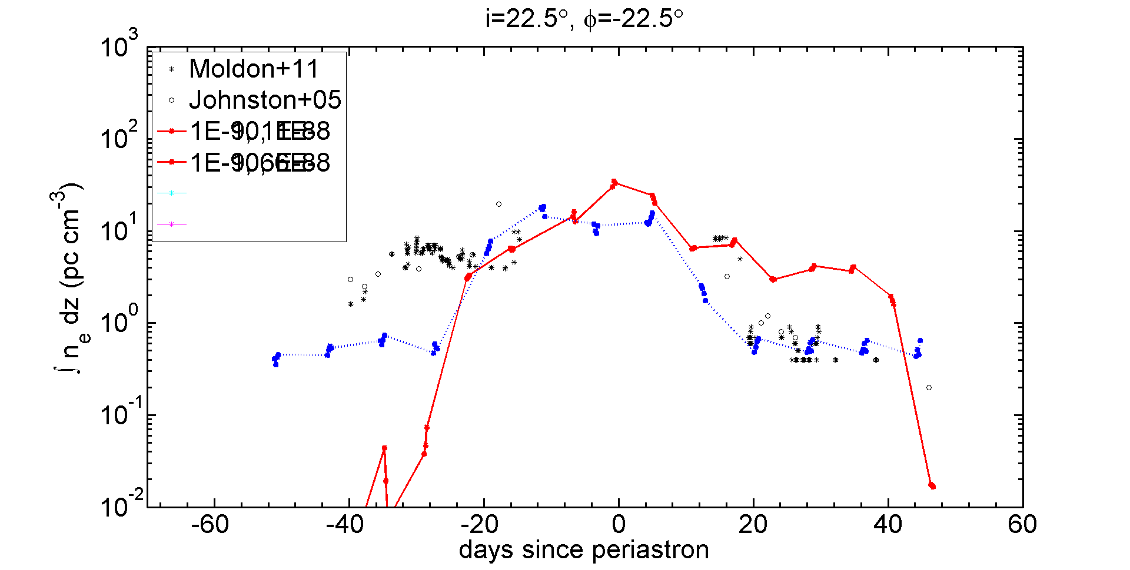
PSR B1259-63: PDM
22°
i=22°
Solid: Be wind ionized Dashed: Be wind & disk ionized

Slide 49
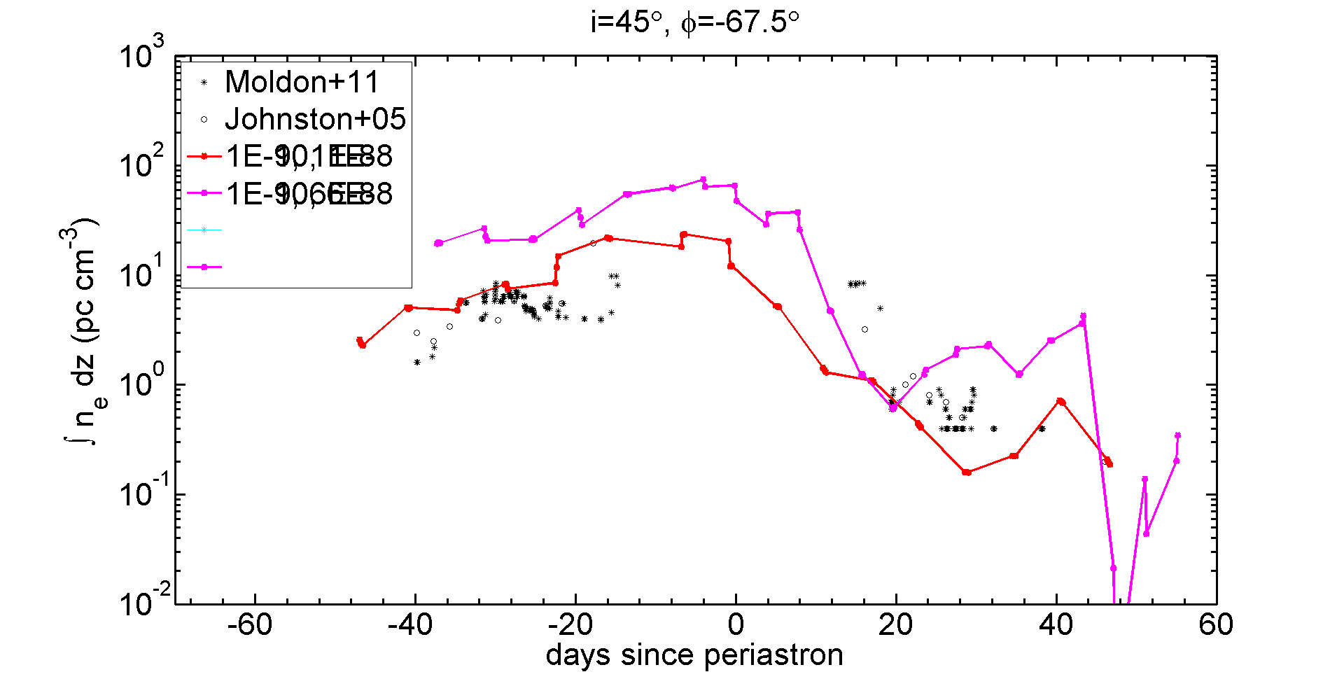
PSR B1259-63: PDM
67°, i=45°
Solid: Be wind ionized Dashed: Be wind & disk ionized

Slide 50
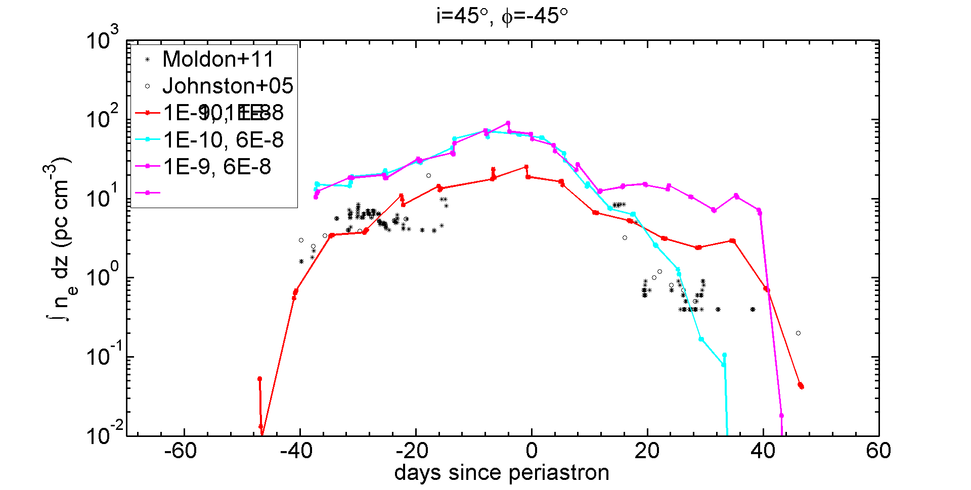
PSR B1259-63: PDM
45°, i=45°
Solid: Be wind ionized Dashed: Be wind & disk ionized

Slide 51
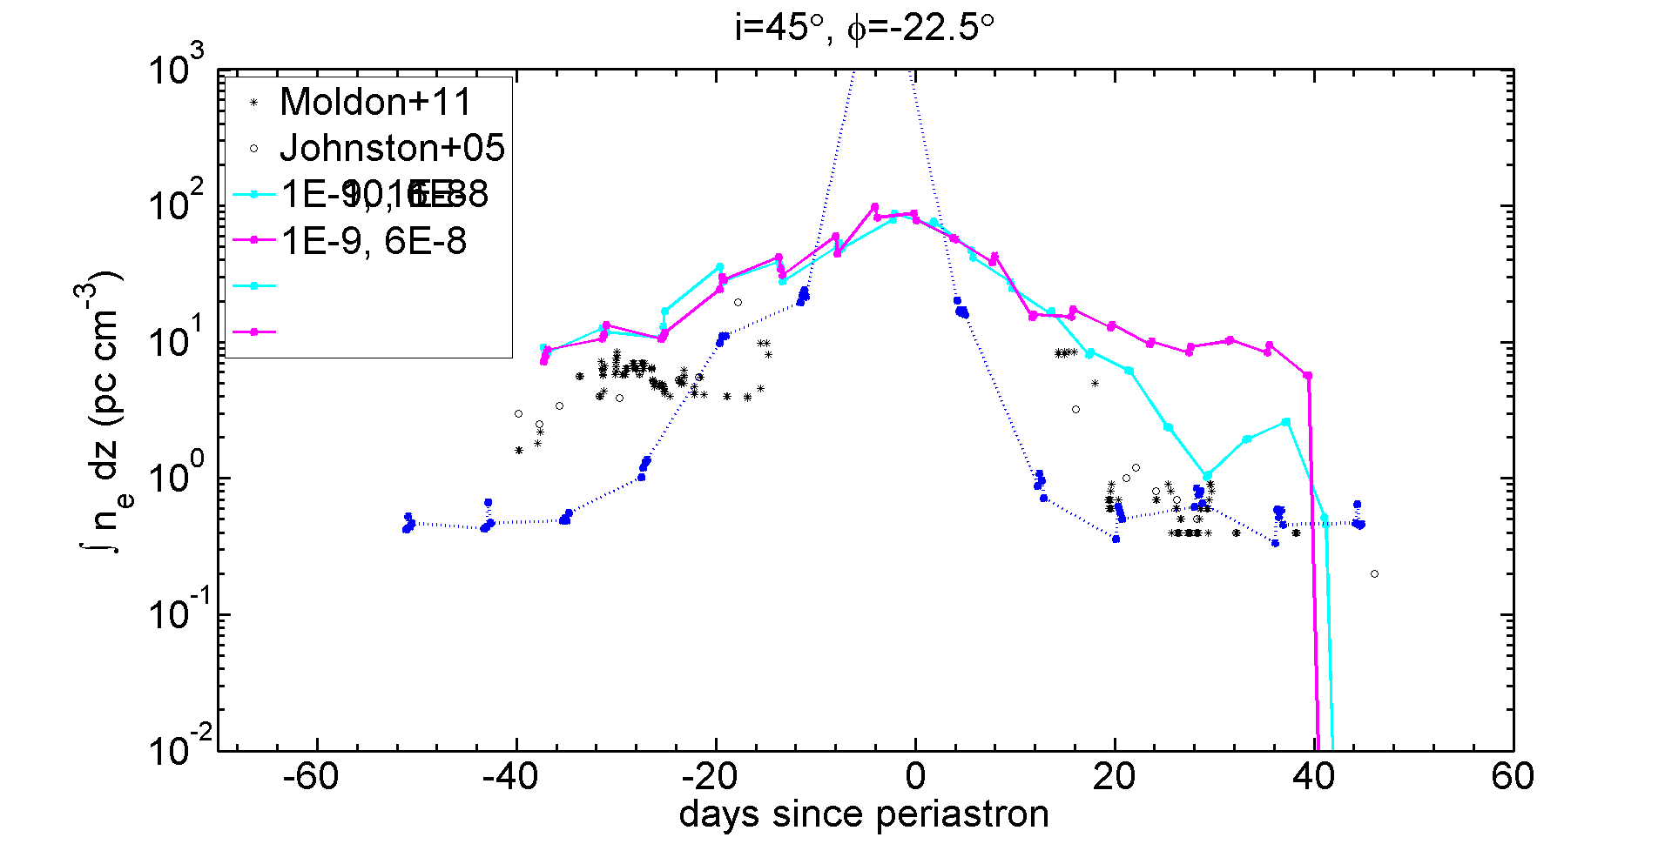
PSR B1259-63: PDM
22°
i=45°
Solid: Be wind ionized Dashed: Be wind & disk ionized

Slide 52
PSR B1259-63: Results
Literature value of i~22° (Moldon+11) has best results
If disk is ionized:
Low mass loss rate (10⁻⁸ M_{ʘ}/yr) & low disk density (10⁻¹⁰ g/cm³)
If disk is not ionized:
Low mass loss rate (10⁻⁸ M_{ʘ}/yr) & high disk density (10⁻⁹ g/cm³)

Slide 53
Future Work
Disk density profile
Model was r^-3.5
Obs evidence of r^{-2.5 to -4} (Rivinius+13)
Orientation of disk in orbital plane
Lesser extent, inclination of disk with respect to orbital plane

Slide 54
360° video of PSR B1259 containing
Be disk, Be wind, & pulsar wind
Android: QR code →
YouTube app
Other smartphones: Open
YouTube App → Search
“Christopher Russell
astronomy”
my icon:
Laptop:
tinyurl.com/cmpr360video
Smartphone and Laptop:
Choose video “PSR B1259 viewed from the Be star”
Note: Identical to slide 3; shown during question and answer portion of talk.

