Slide 1
How to Compare AGNs with Stellar-Mass Black Holes ~ How to challenge “commonly-accepted views” ~
Makishima, K.
RIKEN, Global Research Center

Slide 2
1. BHs with ~10 to ~10⁹ M◎
Motivation:
AGNs, ULXs, and BHBs are all accreting BHs.
It is said: “all these BHs can be scaled by the BH mass M_{BH} and the Eddington ratio η”.
Nevertheless, meaningful comparisons among these classes have been surprisingly poor.
Strategy:
To identify how various properties of mass- accreting BHs scale with M_{BH}.
To make data-oriented (not theory-driven) comparisons among these classes.

Slide 3
2. Luminosity vs. Mass
L/L_{Edd}
© Kubota, Noda, Yamada & Kobayashi
20M◎
Kubot+Makishima 04
10
Slim Disk
NLSy1
1
Very high
ULX 0.3~3x10⁴⁰ erg/s
High/soft (HSS)
0.1
BLSy1
Low/Hard (LHS)
0.01
M/M◎
10
10²
10³
10⁴
10⁵
10⁶
10⁷
10⁸
10⁹
Stellar
AGN

Slide 4
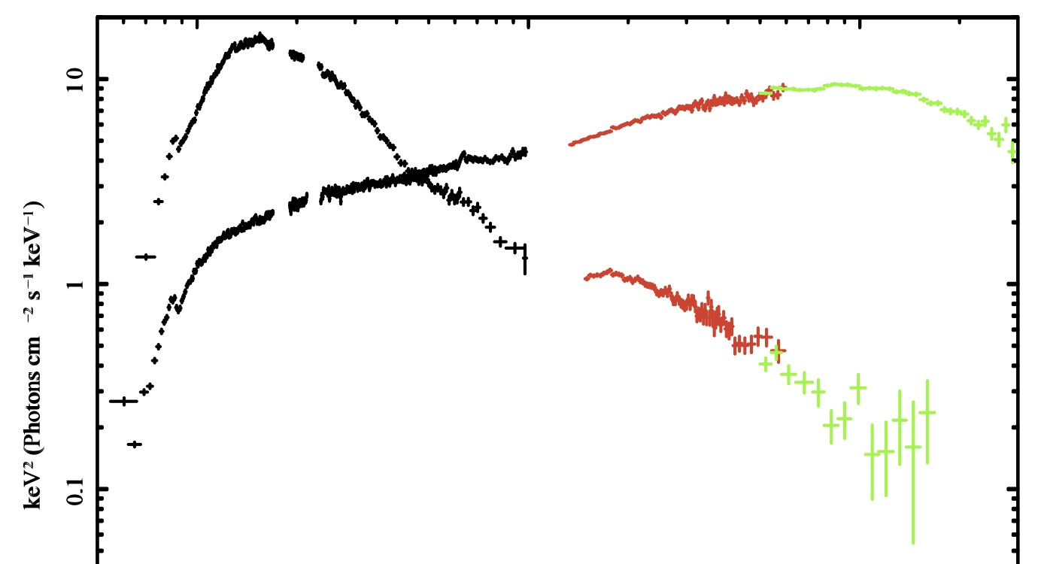
3. Spectral states of Sy1’s
Of the 4 spectral states of BHBs, the HSS and LHS are very well established and understood.
Cyg X-1 with Suzaku (Makishima+08, Yamada+13)
HSS
XIS
HXD-PIN
HXD-GSO
LHS
1 10 100 keV

Slide 5
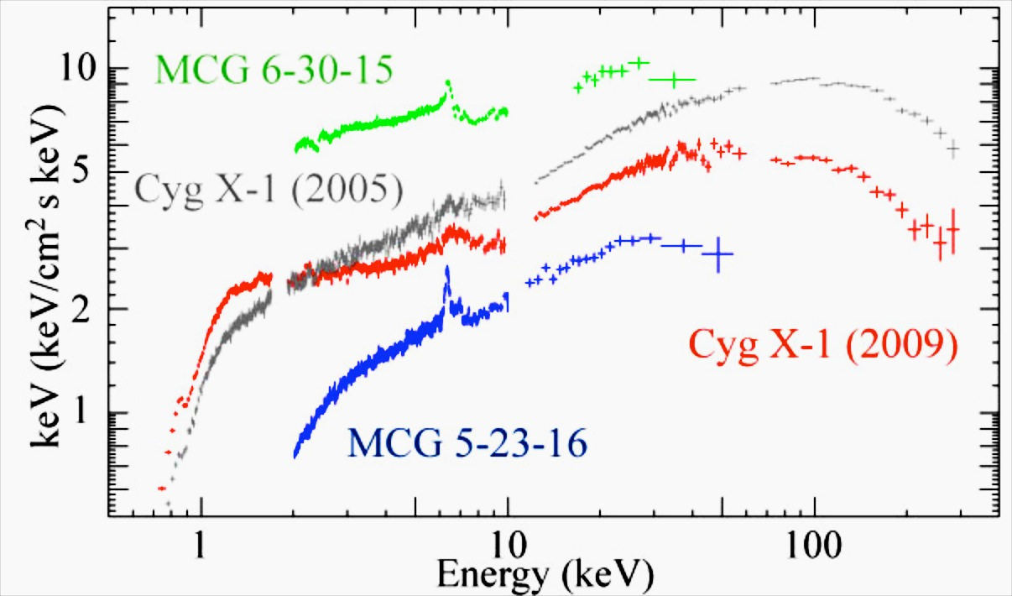
3. Spectral states of Sy1’s
Of the 4 spectral states of BHBs, the HSS and LHS are very well established and understood.
Then, in which spectral state are ordinary (broad line) Sy1’s ?
BL Sy 1’s are ;
In the LHS.
In the HSS.
In a mixture of the two states.
In neither state.
MCG 6-30-15
Cyg X-1 (2009)
Cyg X-1 (2005)
MCG 5-23-16
© S.Yamada & H.Noda (2015)

Slide 6
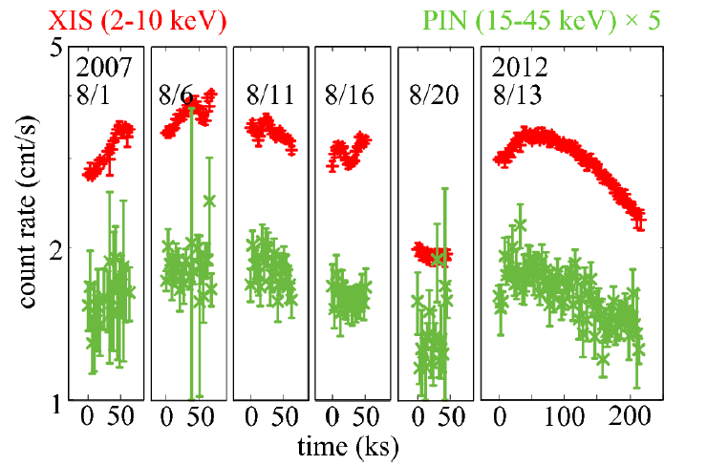
4. Variability-Assisted Spectroscopy of AGNs
NGC 3227 “C3PO” (Count-Count Corr. w/ Positive Offset) (Noda+13,15)
IC4329A (Miyake+15) 2-3 keV and 15-45 keV (×5)
f (t )
V(E)
Vf (t )
V₀
S(E)
2-3 keV LC : f (t )
LC at energy E : V(E)f (t )+S(E )
From LCs at various energies, we can obtain variable spectrum V(E) + stationary spectrum S(E ).
Bright Branch w/ fast variation and Faint Branch w/ slow var.
At energy E in either Branch,
Count (E) = V(E)+S(E)

Slide 7
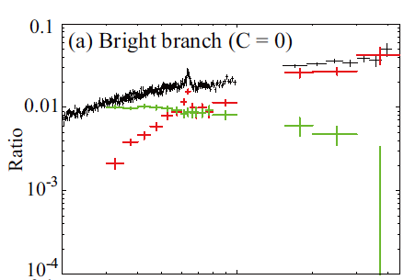
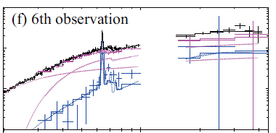
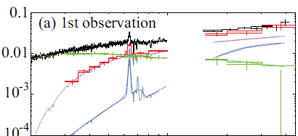
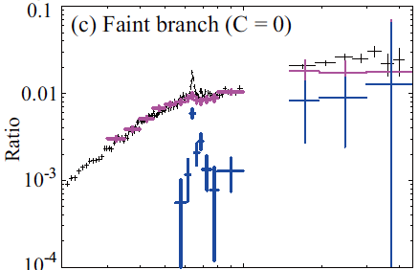
5. Spectral Decomposition of NGC 3227 (Noda+14)
Slow(~weeks) variations in the Faint Branch
Fast (<day) variations in the Bright Branch
2 5 10 20 30 keV
2 5 10 20 30 keV
Total spectrum =
Stationary sig.
+
Variable sig.
Total spectrum =
Stationary sig.
+
Variable sig.
Cold reflection
Γ〜1.5 partially covered PL
⬅Cold reflection +Γ〜1.5 abs.PL
⬅Γ〜2.4 PL

Slide 8
6. A Novel View of Sy1’s (Noda+11,+13,+14)
The 2-50 keV continua of Sy 1’s consist of 3 components;
(1) Highly variable softer primary with Γ~2.4 and low N_{H}. Similar to the hard tail in BHBs in the HSS. (2) Less variable, absorbed, harder primary with Γ~1.5. Similar to the LHS Compton continua in BHBs. (3) Distant reflection produced by (1)+(2).
(1) dominates at η＞0.01, while (2) persists at any η.
(2) can be emission from RIAF inside a truncated disk, and its N_{H} may be due to outflows.
Noda+14
νFν
Fraction of (2) in 6-10 keV

Slide 9
7. Discussion
(cf. Makishima+08)
Hard PL
Soft PL
The first discovery of state transitions in AGNs → ture BHB-AGN link.
Previous studies confused the two PLs. The results need re-evaluation.
The hard PL cannot be partially absorbed part of soft PL: the two continua differ both in Γ and variability.
In NGC 3516, NGC 3227, and IC 4329A, the hard PL cannot be replaced by relativistic reflection.
The hard PL can be regarded as primary RIAF emission.
At low η, the disk is truncated, and does not reach ISCO. In any case, no broad Fe-K line needed.
The absorption on the hard PL suggests an important link to outflows→ ASTRO-H
Hard PL
BH
ADAF
Low η
High η

Slide 10
8. Conclusion
The 2-50 keV continua of Sy 1’s consist of two PL-shaped primary continua with different properties, and secondary reflection.
Relative dominance of the two primary continua depends on the Eddington ratio, possibly involving “state transitions”.
The view provides a nice comparison between AGNs and BHBs,
The study will make a great leap with ASTRO-H.

