Slide 1
Origin of the Spectral Variation and Seemingly Broad Iron Line Feature in Seyfert Galaxies
Ken EBISAWA
ISAS/JAXA

Slide 2
Origin of the Spectral Variation and Seemingly Broad Iron Line Feature in Seyfert Galaxies and Black Hole Binaries
Ken EBISAWA
ISAS/JAXA

Slide 3
Related Papers:
  Inoue, Miyakawa and Ebisawa, 2011, PASJ, 63S, 669
    Methods and application to Suzaku MCG-6-30-15
  Miyakawa, Ebisawa and Inoue, 2012, PASJ, 64, 140
    MCG-6-30-15 with Suzaku and Chandra
  Mizumoto, Ebisawa and Sameshima, PASJ, 2014, 66,122
    1H0707-495 with Suzaku and XMM
  Iso et al. submitted to PASJ
    ~20 Seyfert1 galaxies with Suzaku
  Yamasaki et al. in preparation
    IRAS13224-3809, Mrk 335 and Ark 564,
Essentially, we propose the same model in these papers.

Slide 4
Contents
Introduction
Variable Double Partial Covering (VDPC) Model
Application to Observations
Structure around the AGN
Comparison with BHBs
Conclusion

Slide 5
Contents
Introduction
Variable Double Partial Covering (VDPC) Model
Application to Observations
Structure around the AGN
Comparison with BHBs
Conclusion

Slide 6
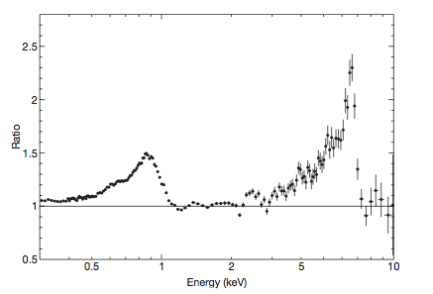
1.Introduction
Broad iron features in AGNs
Iron-K
Iron-L
Iron-K
1H0707-495 with XMM (Fabian+ 2009)
MCG-6-30-15 with ASCA (Tanaka+ 1995)
Look like broad Iron K- and L- emission lines
However, the line shape is dependent on modeling the continuum spectra

Slide 7
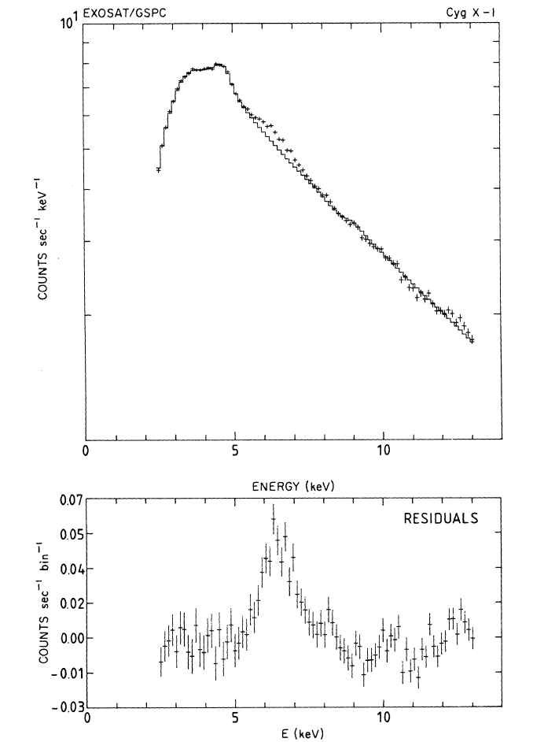
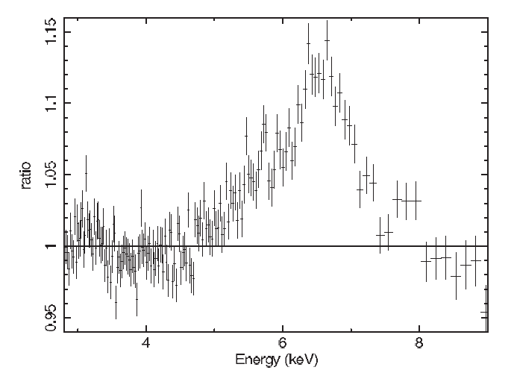
1.Introduction
Broad iron features in BHBs
GRS1915+105 with Suzaku
(Blum et al. 2009)
Cyg X-1 with EXOSAT
(Barr, White and Page 1985)
Broad Iron emission line features also observed from BHBs
Presumably, they have the same origin as in AGNs

Slide 8
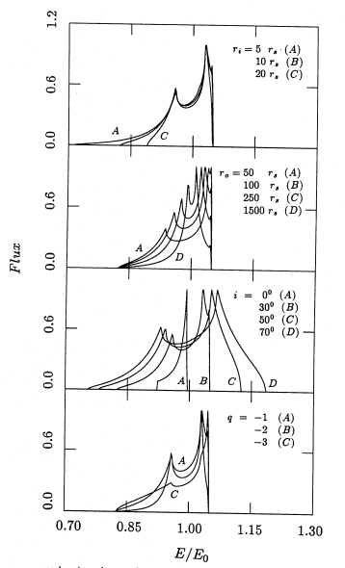
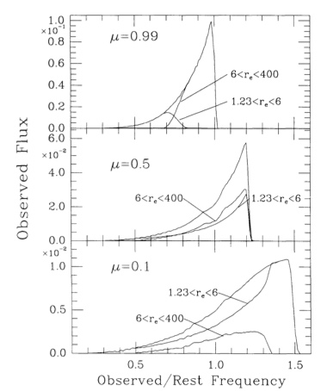
Calculation of iron line profile from inner region of the accretion disk
Schwarzschild black hole
Extreme Kerr black hole
Fabian et al. 1989
These models may explain the observed spectra
Laor 1991

Slide 9
Characteristic spectral variation
〜10⁴ sec
〜10⁵ sec
(Matsumoto+ 2003)
MCG-6-30-15 with ASCA
Energy dependence of the Root Mean Square varation (RMS spectra)
Significant drop in the RMS spectra at the iron K-line
Model independent result → Important key!

Slide 10
Two competing models to explain the seemingly broad iron emission lines
Relativistic disk reflection model
Partial covering model

Slide 11
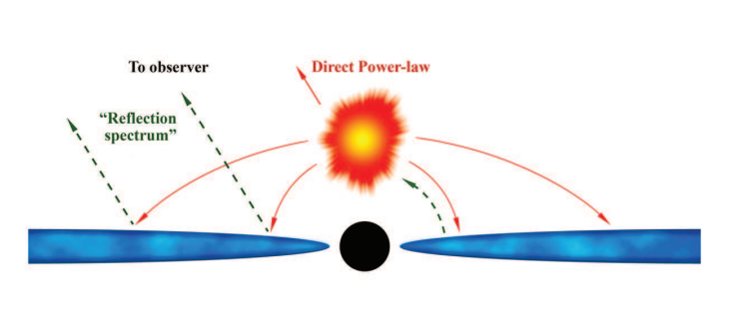
Relativistic disk reflection model
Miniutti and Fabian (2004)
  Accretion disk is illuminated from above by a compact “lump-post” in the very vicinity (~Rs) of the black hole
  The line is relativistically broadened (“disk line”)
  Direct X-rays varies, while the reflection component does not very due to the relativistic “light-bending effect”
Fabian, Kara and Parker (2014)

Slide 12
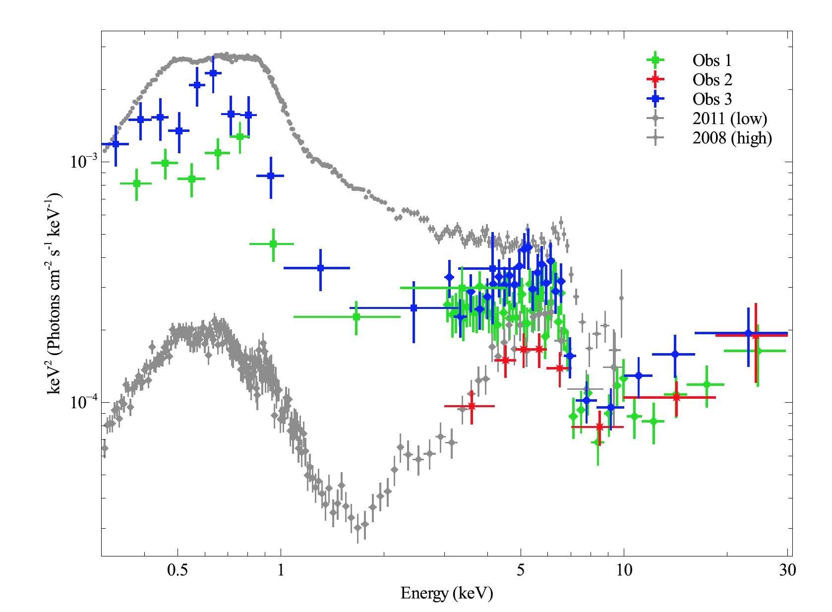
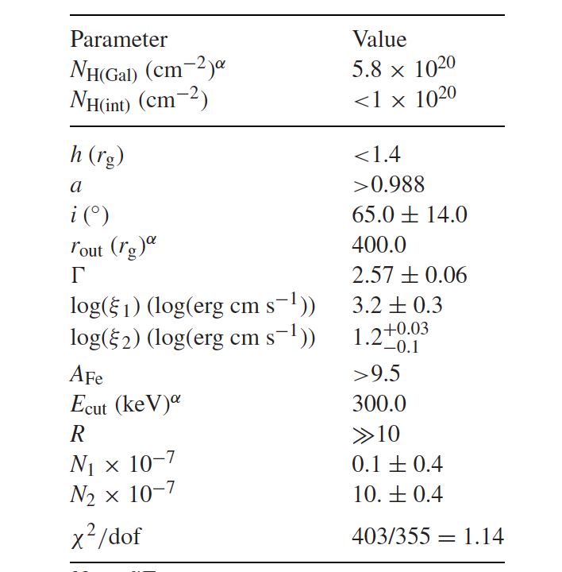
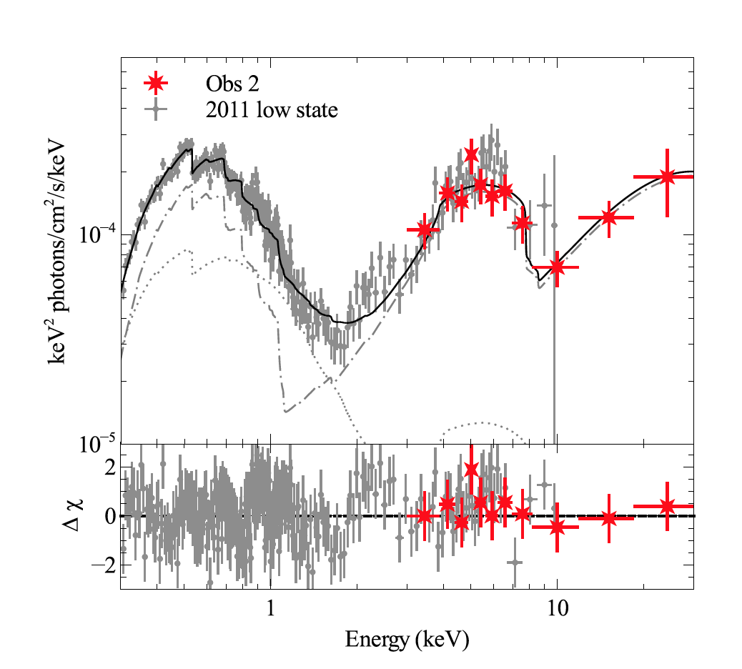
Kara et al. (2015)
1H0707-495
NuStar + XMM
Relativistic disk model
fit is possible, but requires very extreme
condition
No intrinsic absorption
source height very low
Direct X-rays not seen

Slide 13
Partial Covering Model
X-ray emission region is partially covered by intervening absorbers (e.g., Matsuoka+ 1990; McKernan and Yaqoob 1998; Miller, Turner and Reeves 2008, 2009)
RMS explained by variation of warm absorbers (Inoue and Matsumoto 2003)
Variable Double Partial Covering Model (Miyakawa, Ebisawa and Inoue 2012)
  Absorbers have internal ionization structure
  Intrinsic X-ray luminosity from the AGN does not vary significantly in 1- 10 keV
  Most observed X-ray spectral variation (< day) is explained by change of the partial covering fraction

Slide 14
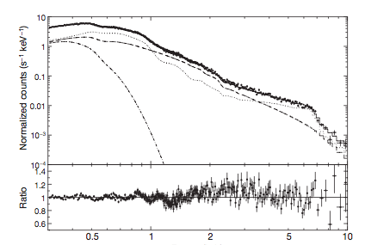
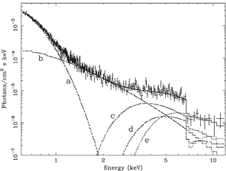
Two spectral models are degenerate
Relativistic disk reflection model
Disk reflection
component
1H0707-495 with XMM (Fabian+ 2009)
X-ray emission region is required to be very compact (~Rs) so that the relativistic disk reflection takes place
Direct
component
Partial covering model
1H0707-495 with XMM (Tanaka+ 2004)
Direct
component
Partial covering clouds with a size of ~several Rs at a radius of ~100 Rs
Absorbed
component
The same X-ray spectra can be fitted by very different models

Slide 15
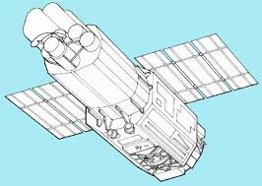
How can we distinguish the two models?
Relativisitc disk reflection model requires the X-ray emission region to be very compact
Absorbing clouds
~10 Rs
X-ray emission
Region ~Rs
X-rays
Satellite
Distance to the absorbing clouds
~100Rs
When the absorbing cloud size is larger than the X-ray source size,
partial covering does NOT take place (always full-covering)

Slide 16
How can we distinguish the two models?
Partial covering model requires the X-ray emission region extended
X-ray emission
Region ~10Rs
Absorbing clouds
~10 Rs
X-rays
Satellite
Distance to the absorbing clouds
~100Rs
When the X-ray source size is greater than or
comprative to the absorber size, partial covering does take place

Slide 17
How can we distinguish the two models?
If we can find evidence of the partial covering
  The X-ray emission region is extended
  Relativistic disk reflection is unlikely

Slide 18
Recently, evidence of the partial covering in AGN being accumulated
Ursini et al. (2015), NGC5548
Parker, Walton, Fabian and Risaliti (2014), NGC1365
Pounds (2014), PG1211+143
etc, etc…

Slide 19
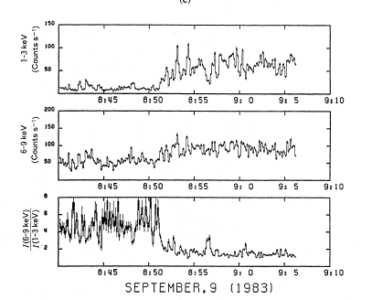
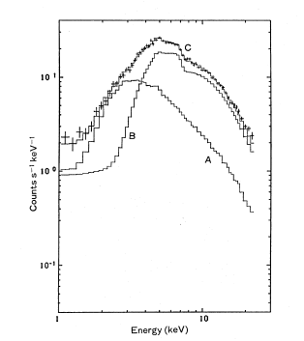
Evidence of partial covering in BHBs
Superior-conjunction in Cyg X-1
  Spectral hardening during dips
Spectra during the dip period
Heavily
absorbed
component
Direct (non-
Absorbed)
component
Partial covering model successful
Kitamoto et al. (1985) with Tenma
X-ray source extended!

Slide 20
Contents
Introduction
Variable Double Partial Covering (VDPC) Model
Application to Observations
Structure around the AGN
Comparison with BHBs
Conclusion

Slide 21
Contents
Introduction
Variable Double Partial Covering (VDPC) Model
Application to Observations
Structure around the AGN
Comparison with BHBs
Conclusion

Slide 22
2. Variable Double Partial Covering (VDPC) Model
Satellite
X-ray source
( 1- α+ α exp(-N_{H}^{(k)}σ(ξ_{k})) × (1-α + α exp(-N_{H}^{(n)}σ(ξ_{n}))
Partial covering by thick and cold absorbers with the partial covering fraction α
Partial covering by thin and hot absorbers with the same α
Responsible for iron K-edge
Responsible for iron L-edge

Slide 23
However, It is hard to imagine two separate layers with the same partial covering fraction so…
Satellite
X-ray source

Slide 24
However, It is hard to imagine two separate layers with the same partial covering fraction so…
Satellite
X-ray source
Thick and cold core responsible for the iron K-edge
Thin and hot envelope responsible for the iron L-edge
Presumably, the partial absorbers have inner structures;
thick and cold core and thin and hot envelope

Slide 25
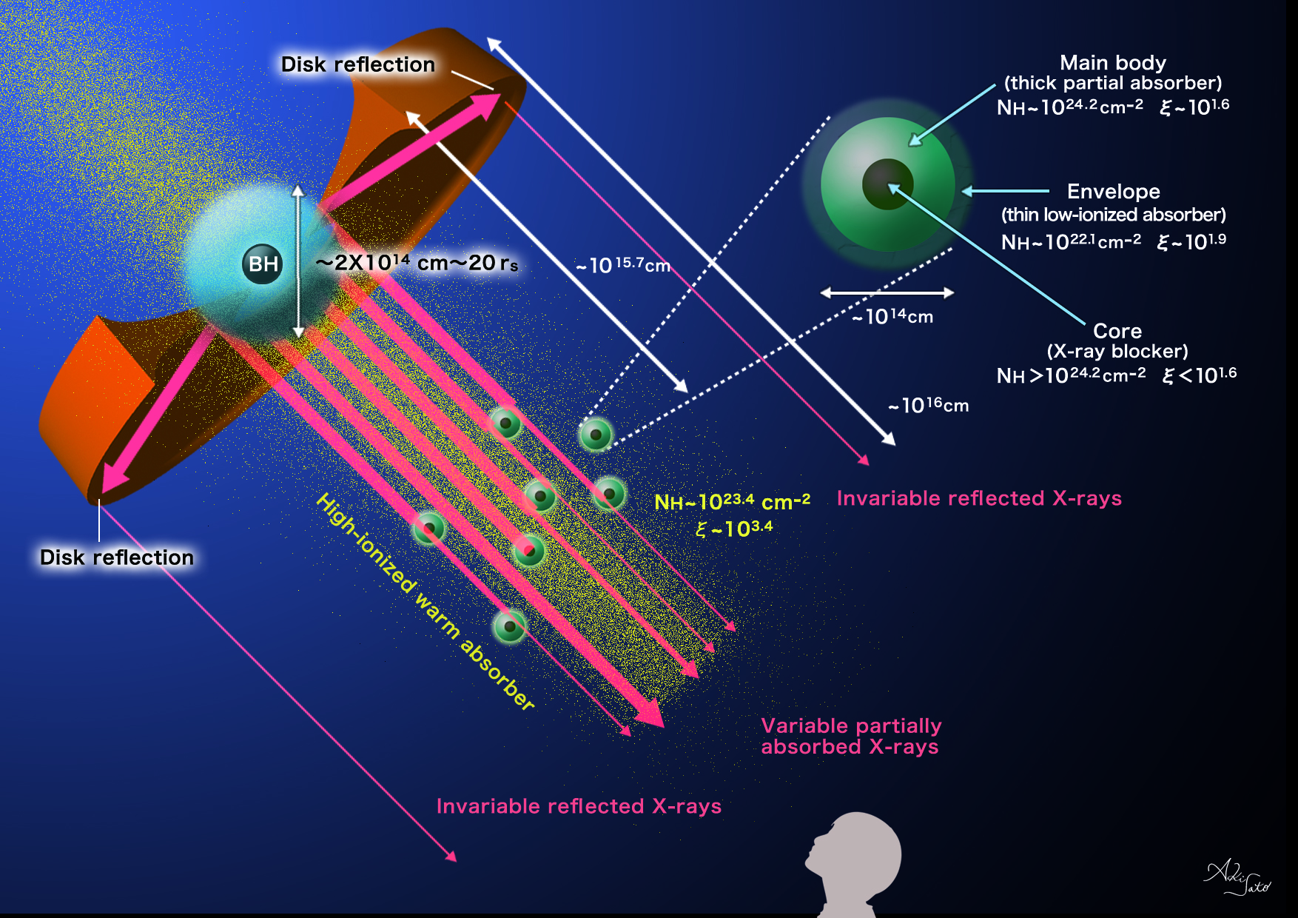
Miyakawa, Ebisawa and Inoue (2012)

Slide 26
Variable Double Partial Covering Model
AGN luminosity and spectra do not vary significantly within ~a day. Variation of the partial covering fraction explain most of the observed spectral variations.
Notes:
このModelは最小限のパラメータでスペクトル変化を説明するわけですが、そのパラメータとは、BHからのX線を電離吸収体が隠している割合を示す、カバーリングファクターというパラメータです。また、このModelではX線源の光度ほとんど変化しないと考えています。
下の図はずざく衛星が観測したMCG−6の強度別スライススペクトルで、横軸がエネルギー、縦軸が強度を表しています。Modelの成分として、赤でdirect componentと青で吸収成分を表しています。
右の図は、さきほど示したModelの状況において、X線源を真正面から見たときの様子を表しています。
電離吸収体がX線源をほとんど覆っている場合、スペクトルの強度は小さくなります。

Slide 27
Variable Double Partial Covering Model
AGN luminosity and spectra do not vary significantly within ~a day. Variation of the partial covering fraction explain most of the observed spectral variations.
Extended
X-ray source
direct component
absorbed component
Partial absorbers with inner structure
MCG-6-30-15 (Miyakawa, Ebisawa and Inoue 2012)
Notes:
このModelは最小限のパラメータでスペクトル変化を説明するわけですが、そのパラメータとは、BHからのX線を電離吸収体が隠している割合を示す、カバーリングファクターというパラメータです。また、このModelではX線源の光度ほとんど変化しないと考えています。
下の図はずざく衛星が観測したMCG−6の強度別スライススペクトルで、横軸がエネルギー、縦軸が強度を表しています。Modelの成分として、赤でdirect componentと青で吸収成分を表しています。
右の図は、さきほど示したModelの状況において、X線源を真正面から見たときの様子を表しています。
電離吸収体がX線源をほとんど覆っている場合、スペクトルの強度は小さくなります。

Slide 28
Variable Double Partial Covering Model
AGN luminosity and spectra do not vary significantly within ~a day. Variation of the partial covering fraction explain most of the observed spectral variations.
Covering fraction varies
MCG-6-30-15 (Miyakawa, Ebisawa and Inoue 2012)
Notes:
電離吸収体がX線源を隠す割合が減っていくと、direct componentが増えて吸収成分が減ります。
逆に、電離吸収体が隠すと、direct componentが減り、吸収成分が増えます。
この変化を表しているのがカバーリングファクターというパラメータです。

Slide 29
Variable Double Partial Covering Model
AGN luminosity and spectra do not vary significantly within ~a day. Variation of the partial covering fraction explain most of the observed spectral variations.
Covering fraction varies
MCG-6-30-15 (Miyakawa, Ebisawa and Inoue 2012)

Slide 30
Variable Double Partial Covering Model
AGN luminosity and spectra do not vary significantly within ~a day. Variation of the partial covering fraction explain most of the observed spectral variations.
Covering fraction varies
MCG-6-30-15 (Miyakawa, Ebisawa and Inoue 2012)

Slide 31
Variable Double Partial Covering Model
AGN luminosity and spectra do not vary significantly within ~a day. Variation of the partial covering fraction explain most of the observed spectral variations.
Covering fraction varies
MCG-6-30-15 (Miyakawa, Ebisawa and Inoue 2012)

Slide 32
Variable Double Partial Covering Model
AGN luminosity and spectra do not vary significantly within ~a day. Variation of the partial covering fraction explain most of the observed spectral variations.
Covering fraction varies
MCG-6-30-15 (Miyakawa, Ebisawa and Inoue 2012)

Slide 33
Variable Double Partial Covering Model
AGN luminosity and spectra do not vary significantly within ~a day. Variation of the partial covering fraction explain most of the observed spectral variations.
Covering fraction: Null
MCG-6-30-15 (Miyakawa, Ebisawa and Inoue 2012)

Slide 34
Contents
Introduction
Variable Double Partial Covering (VDPC) Model
Application to Observations
Structure around the AGN
Comparison with BHBs
Conclusion

Slide 35
Contents
Introduction
Variable Double Partial Covering (VDPC) Model
Application to Observations
Structure around the AGN
Comparison with BHBs
Conclusion

Slide 36
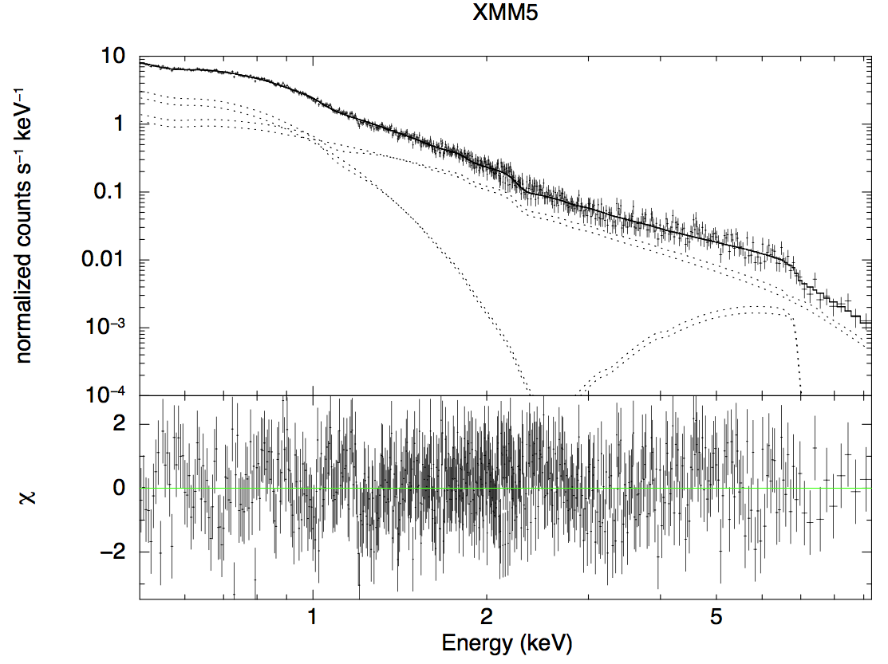
3. Application to Observations: spectral fits
Iron L-feature
due to thin/hot absorber
1H0707-495 (XMM, EPIC)
Power-law
component
Iron K-feature due to
thick/cold absorber
Optically thick disk
component
Thick/cold absorber:
N_{H}~10²⁴cm⁻², ξ~10^{0.1-0.3}
Thin/hot absorber:
N_{H}~10²³cm⁻², ξ~10³
Mizumoto, Ebisawa and Sameshima (2014)

Slide 37
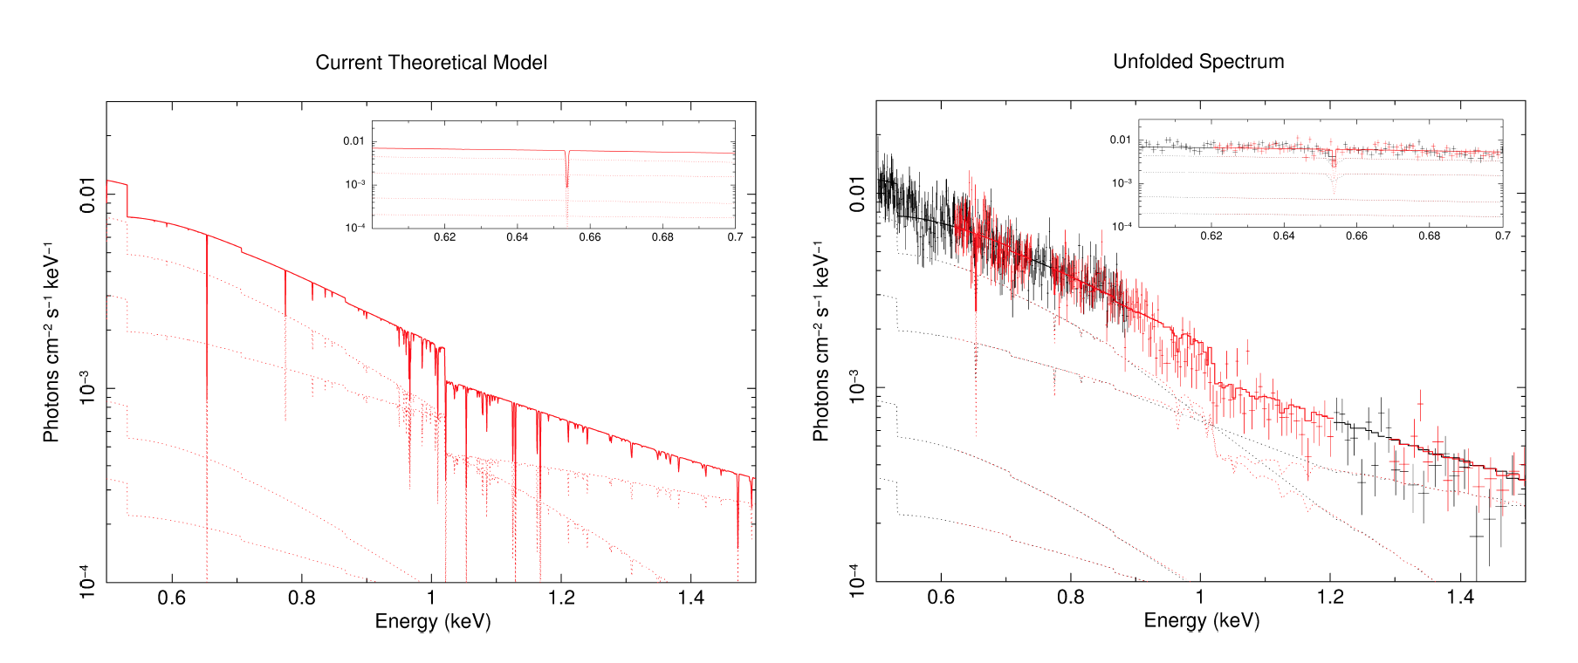
1H0707+495 iron-L and other low-energy feature
Model (based on EPIC)
RGS spectral fit
Mizumoto, Ebisawa and Sameshima (2014)
Iron-L and weak absorption line features
consistent with the RGS spectra

Slide 38
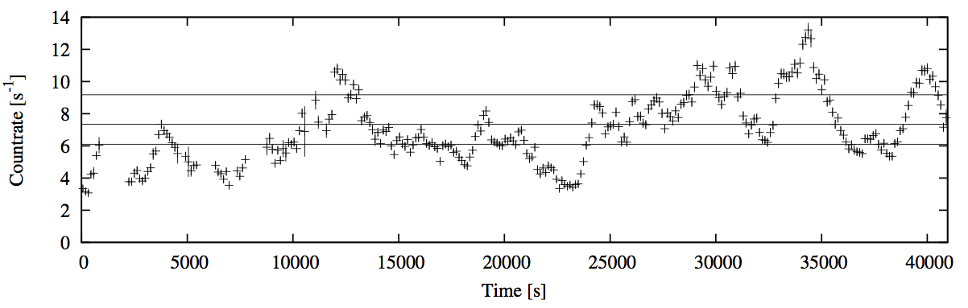
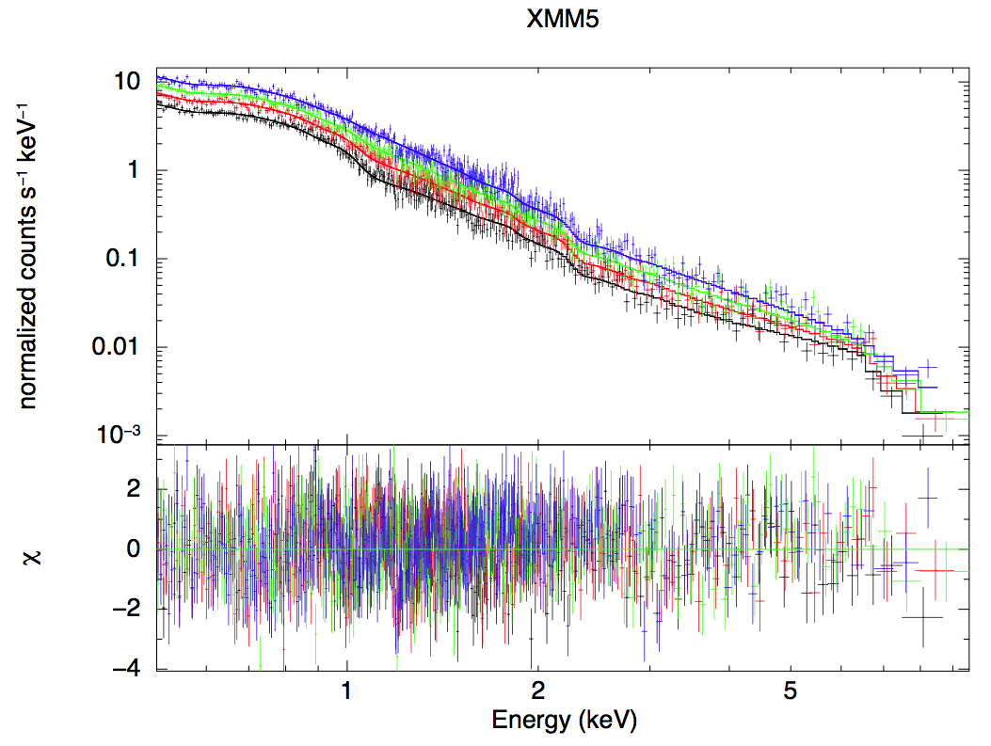
3. Application to Observations: flux-sorted spectral fits
1H0707-495 (XMM)
Observation within ~a day is divided into four different flux levels
Flux-sorted spectra are fitted simultaneously only varying the partial covering fraction.
Mizumoto, Ebisawa and Sameshima (2014)

Slide 39
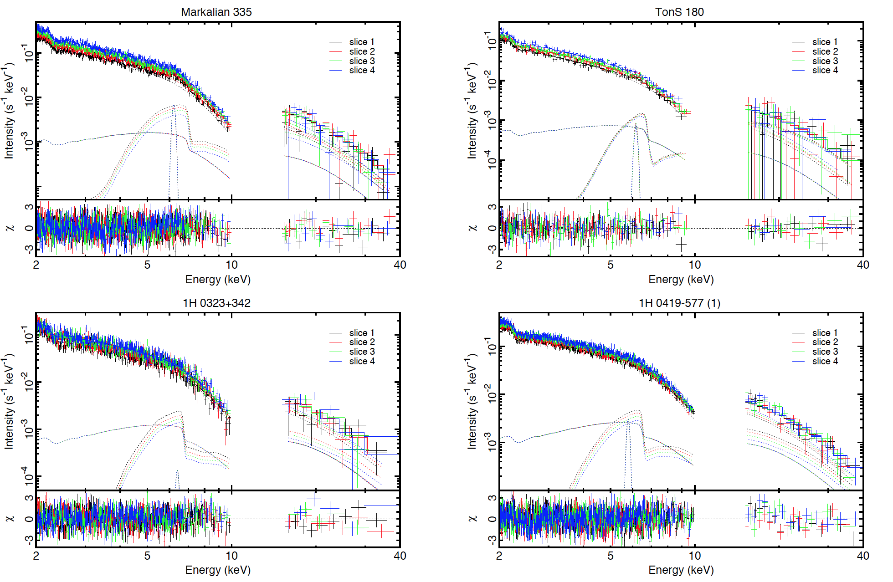
Flux-sorted spectra fitted simultaneously only varying the partial covering fraction.
Iso et al. (2015)

Slide 40
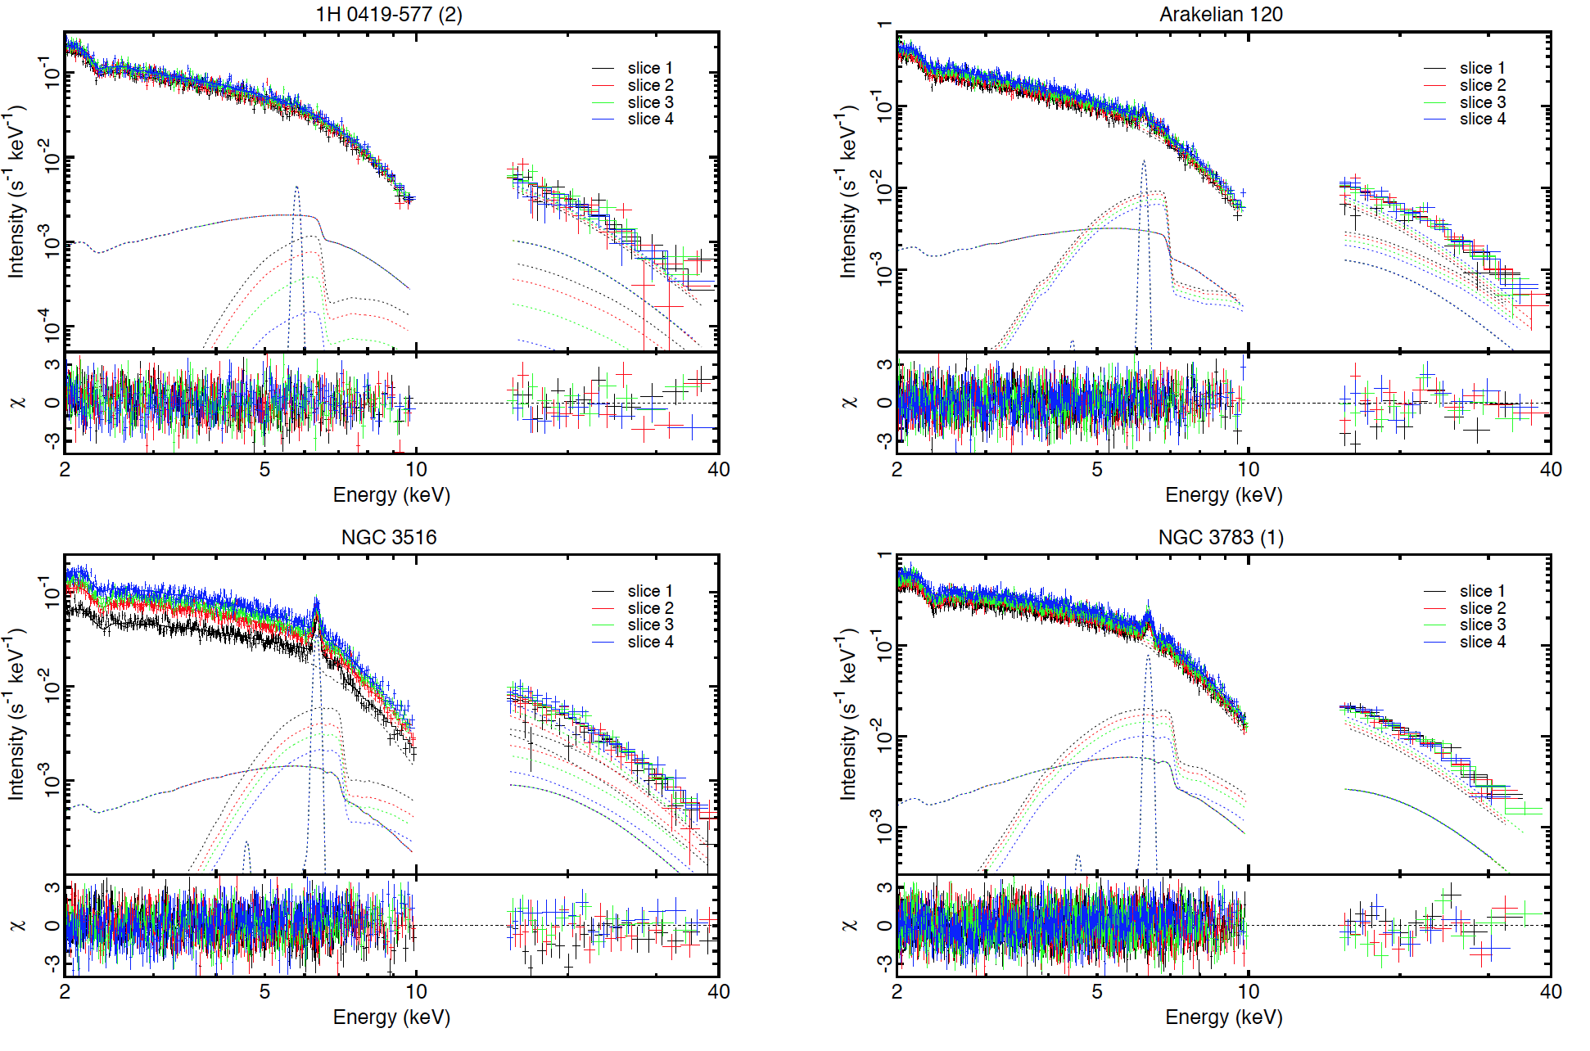
Flux-sorted spectra fitted simultaneously only varying the partial covering fraction.
Iso et al. (2015)

Slide 41
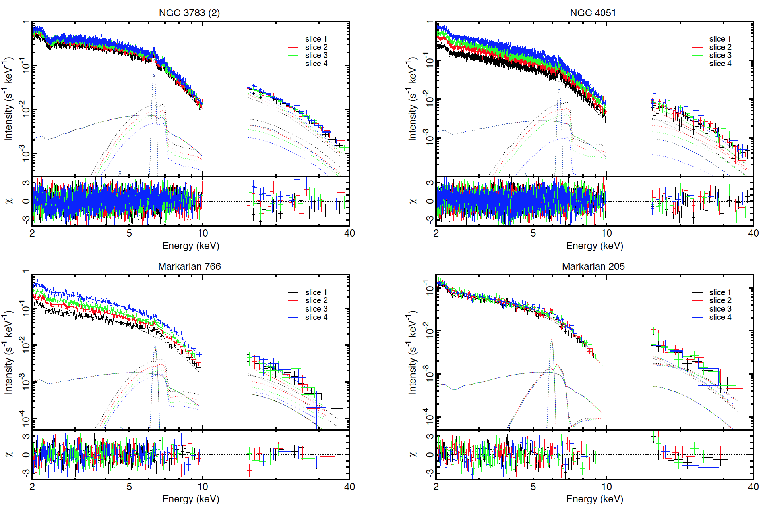
Flux-sorted spectra fitted simultaneously only varying the partial covering fraction.
Iso et al. (2015)

Slide 42
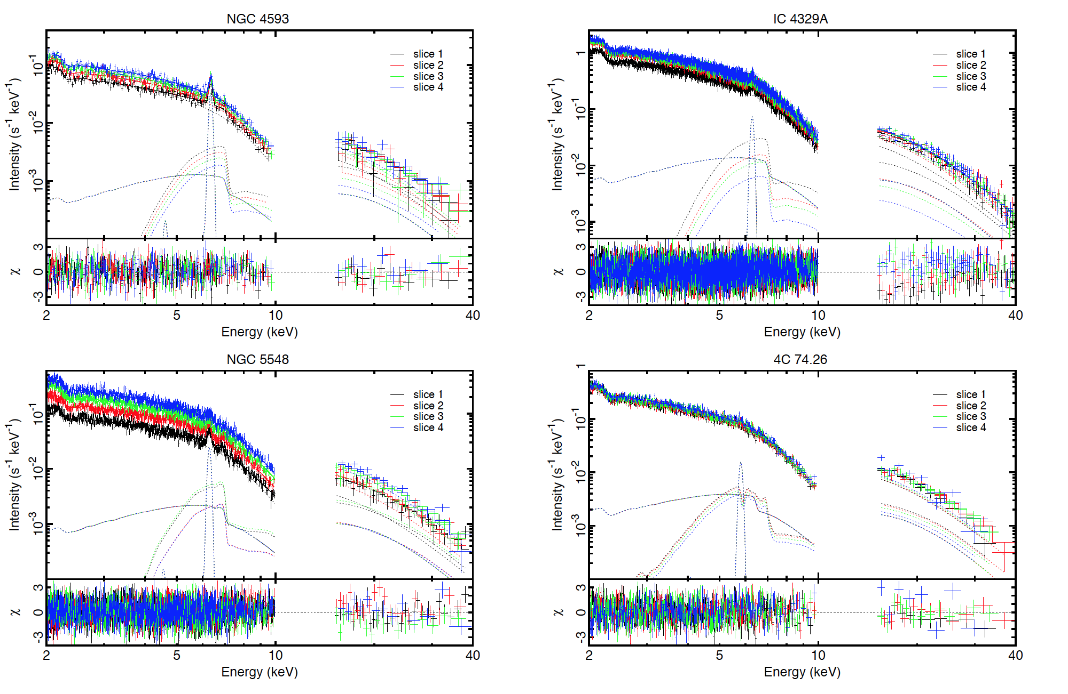
Flux-sorted spectra fitted simultaneously only varying the partial covering fraction.
Iso et al. (2015)

Slide 43
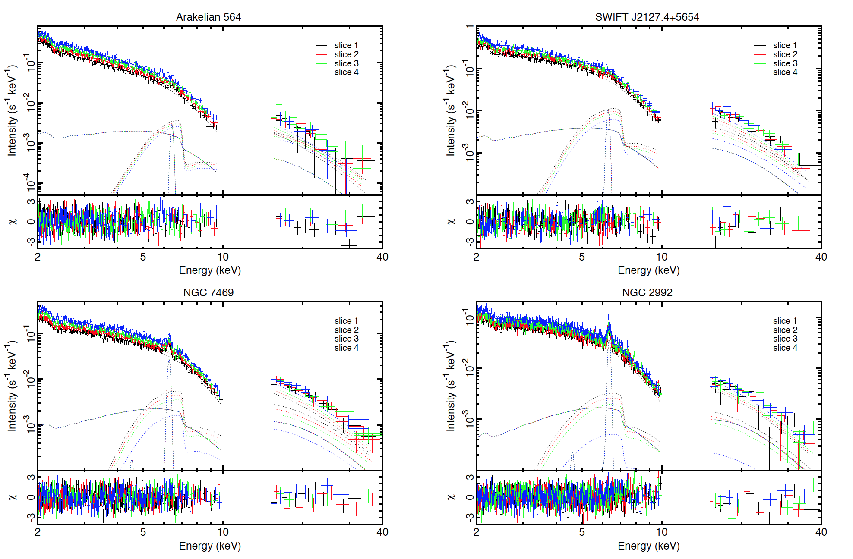
Flux-sorted spectra fitted simultaneously only varying the partial covering fraction.
Iso et al. (2015)

Slide 44
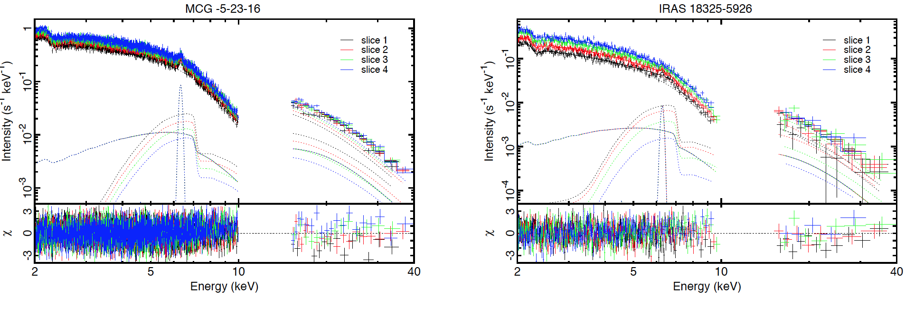
Flux-sorted spectra fitted simultaneously only varying the partial covering fraction.
Iso et al. (2015)

Slide 45
3. Application to Observations:
RMS spectra
〜10⁴ sec
〜10⁵ sec
(Matsumoto+ 2003)
MCG-6-30-15 with ASCA
Energy dependence of Root Mean Square (RMS) variation
RMS spectra of the Seyfert galaxies with broad iron features show significant drop at the iron K energy band

Slide 46
3. Application to Observations:
RMS spectra
In the VDPC model, variations of the direct component and the absorbed component cancel each other
This is most effective in the iron K- energy band
RMS spectral characteristics of MCG-6-30-15 explained (Inoue, Miyakawa, Ebisawa 2011; Miyakawa, Ebisawa and Inoue 2012)

Slide 47
3. Application to Observations:
RMS spectra
In the VDPC model, variations of the direct component and the absorbed component cancel each other
This is most effective in the iron K- energy band
direct compoent
absorbed
component
reflection
Iron line
Iso et al. (2015)

Slide 48
3. Application to Observations:
RMS spectra
解析
Observed Root Mean Square spectrum is explained by only variation of the covering fraction
Black:data
Red:model
Iso et al. (2015)
Notes:
次にRMSスペクトルとModelを比較しました。
図はNGC3516のRMSスペクトルで、データとModelがよく一致しています。
また、鉄輝線あたりの時間変動も再現できています。

Slide 49
Example of
other sources
Black:data
Red:model
Iso et al.
(2015)

Slide 50
Example of
other sources
Black:data
Red:model
Iso et al.
(2015)

Slide 51
Example of
other sources
Black:data
Red:model
Iso et al.
(2015)

Slide 52
Characteristic iron-L feature in the RMS spectra
Iron L-peaks are seen in the RMS spectra when iron L-absorption edges are particularly strong.
Naturally explained with the VDPC model, where the fluxes of the direct component and the absorbed component exhibit anti-correlation.
The fractional variation peaks at the energy where the flux separation between the two spectral components is the widest.
Yamasaki et al. (2015)

Slide 53
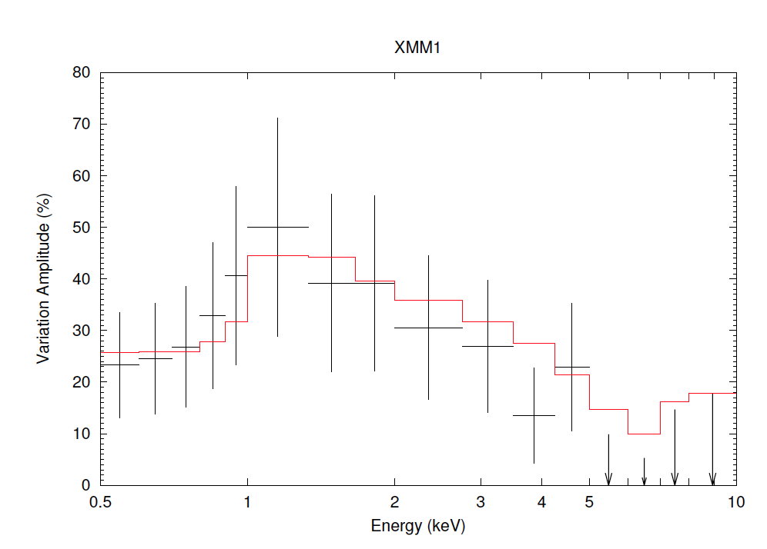
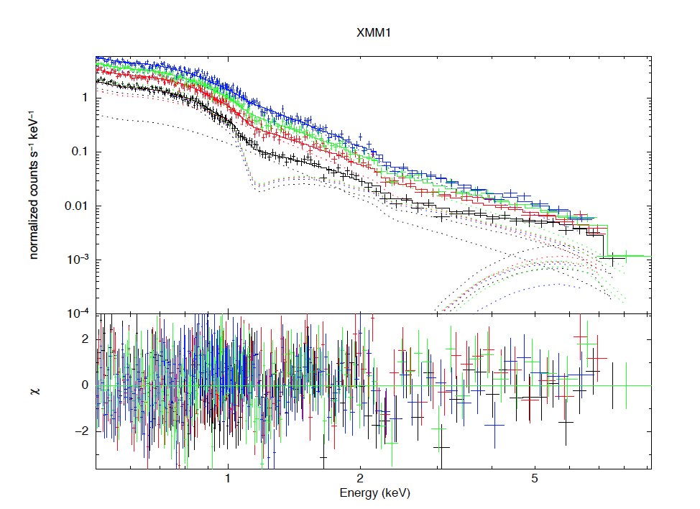
Characteristic iron-L feature in the RMS spectra
IRAS13224-3809
Yamasaki et al. (2015)

Slide 54
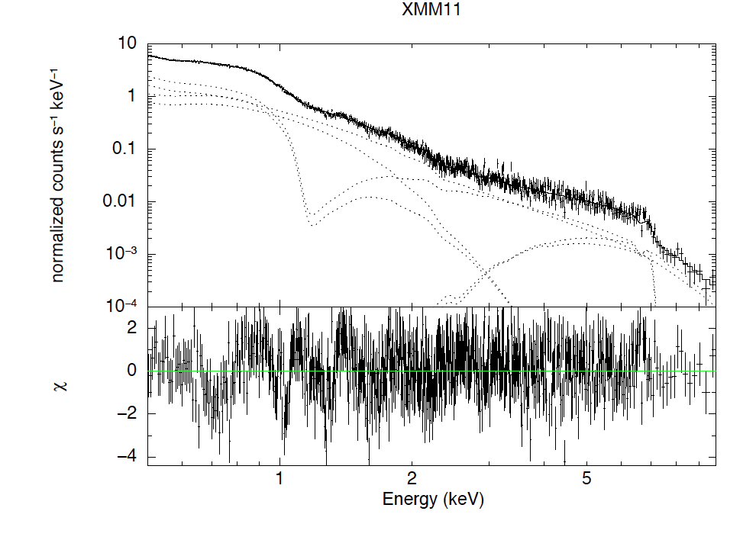
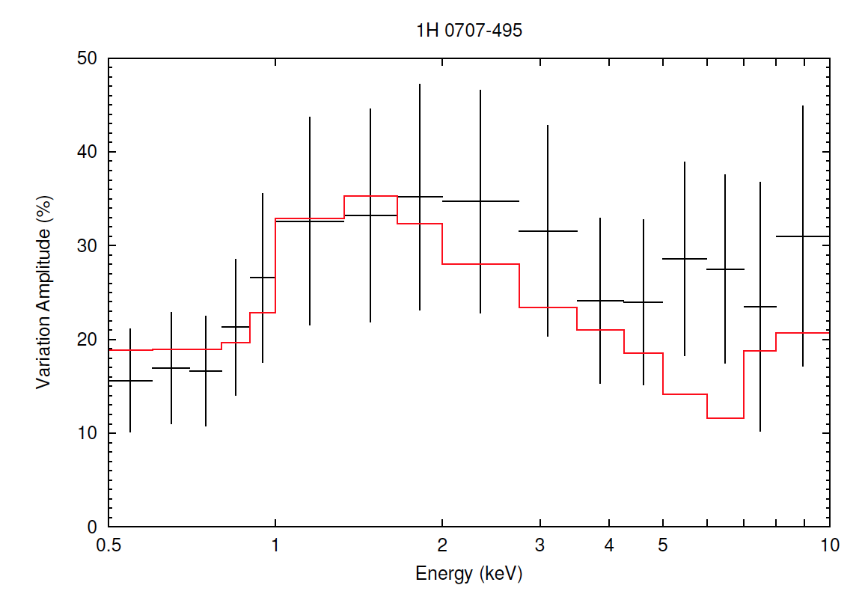
Characteristic iron-L feature in the RMS spectra
1H0707-495
Yamasaki et al. (2015)

Slide 55
3. Application to Observations: light curves
We examine if light curves (512 sec bin) in different energy bands are explained by the VDBC model.
From the 0.5-10 keV counting rates, we calculate α for each bin, from which we calculate model light curves in 0.5-1.0 keV (Soft), 1.0 keV-3.0 keV (Medium) and 3.0-10 keV (Hard).
Compare the simulate light curves in the three energy bands with the observed ones.

Slide 56
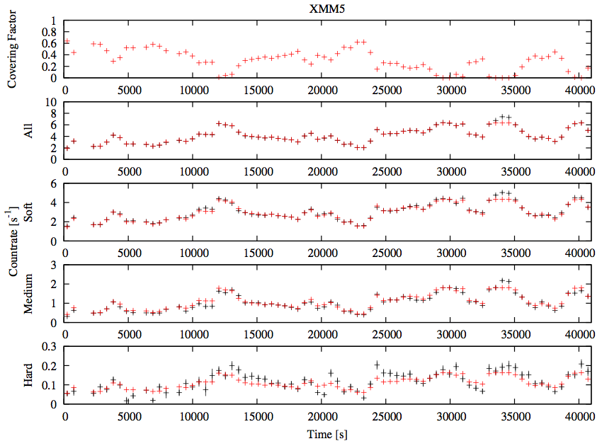
Red: model
Black: data
1E0707-495 with XMM
Mizumoto, Ebisawa and Sameshima (2014)

Slide 57
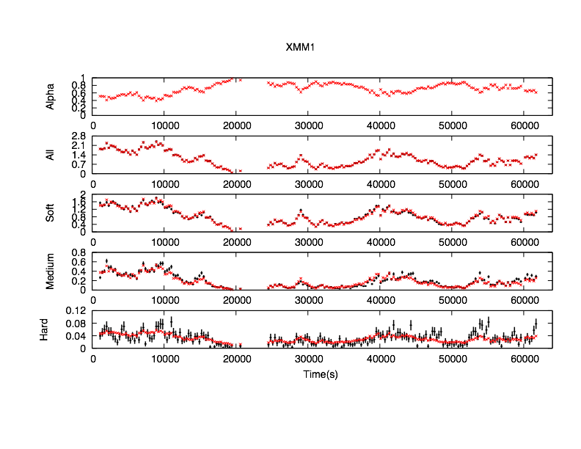
Red: model
Black: data
IRAS13224-3809 with XMM
Yamasaki et al. (2015)

Slide 58
3. Application to Observations: light curves
Soft band (0.5-1.0 keV) light curves are explained by the VDPC model.
Agreement between model and data is reasonably in Medium (1.0-3.0 keV) and Hard (3.0 -10keV) band, but worse in higher energies.
Deviation in the Hard band indicates intrinsic variation of the hard spectral component.

Slide 59
Contents
Introduction
Variable Double Partial Covering (VDPC) Model
Application to Observations
Structure around the AGN
Comparison with BHBs
Conclusion

Slide 60
Contents
Introduction
Variable Double Partial Covering (VDPC) Model
Application to Observations
Structure around the AGN
Comparison with BHBs
Conclusion

Slide 61
4. Structure around the AGN
Covering fraction can be large (α>0.9) in the VDPC model.
Significant fluorescent iron lines (6.4 keV) are not observed.
  Absorbers are preferential located in the line of sights

Slide 62
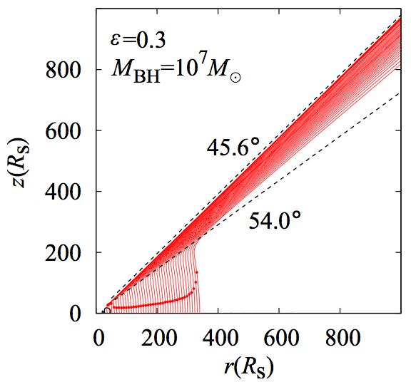
4. Structure around the AGN
Disk winds simulation:
outflows are limited in a narrow
range of the zenith angle
Partially
Absorbed
X-rays
Line-of-sight is aligned to the outflow?
Nomura et al. (2013)

Slide 63
Contents
Introduction
Variable Double Partial Covering (VDPC) Model
Application to Observations
Structure around the AGN
Comparison with BHBs
Conclusion

Slide 64
Contents
Introduction
Variable Double Partial Covering (VDPC) Model
Application to Observations
Structure around the AGN
Comparison with BHBs
Conclusion

Slide 65
Comparison of BHB and AGN RMS spectra
If the broad iron line production mechanism is identical in AGN and BHB, we should expect the same RMS spectra, where the timescale is normalized by BH mass.
High-quality spectral-timing analysis has been difficult for BHB, because typical CCD time-resolution (~several seconds) is not sufficient
Studying BHB with CCD with ~msec time-resolution is recently made possible (using Suzaku P-sum mode; Mizumoto et al. 2015)

Slide 66
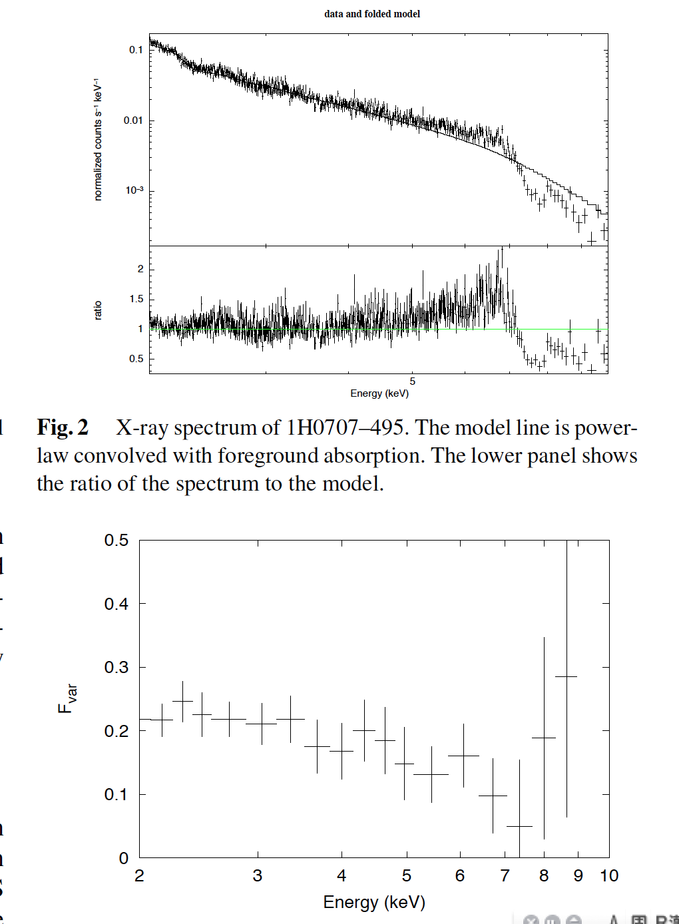
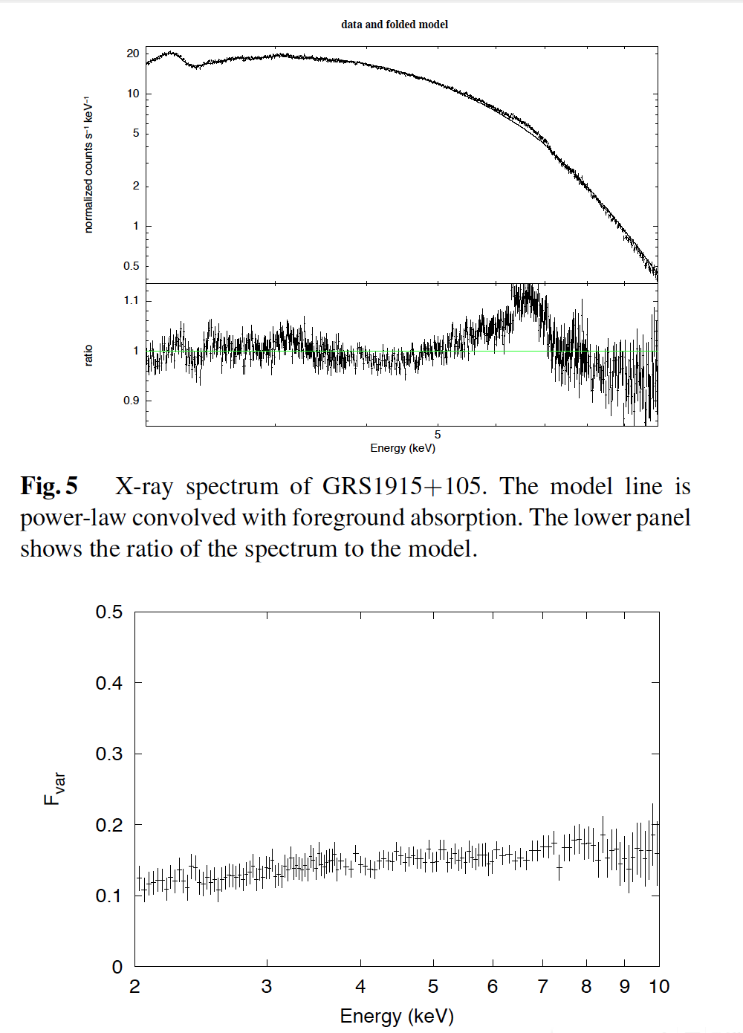
10⁵ BH
mass
difference
Mizumoto et al. (2015)
1H0707+405 with Suzaku
GRS1915+105 with Suzaku
Energy Spectra of Variable Component
ΔT=8000sec
Energy Spectra of Variable Component
ΔT=80msecsec
Broad iron line feature is NOT normalized by the black hole mass

Slide 67
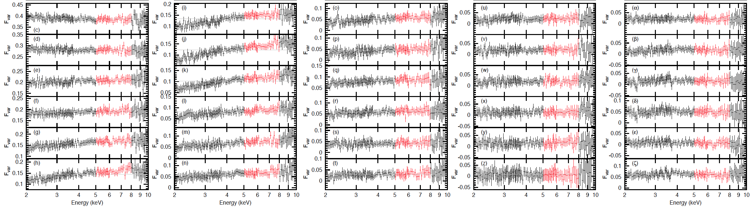
Mizumoto et al. (2015)
Iron line variation is not found in any time scales (ΔT=16msec~64 ksec)

Slide 68
Origin of the difference between the AGN and BHB broad iron-line variation
In principle, the X-ray luminosity variation (t_{lum}) and the variation of the partial absorption (t_{abs}) have different time scales
In AGN, t_{lum} >> t_{abs}
  Spectral feature due to only change of the partial absorption is observed
In BHB, t_{lum} ≈ t_{abs}
  Two independent spectral variations cancelled

Slide 69
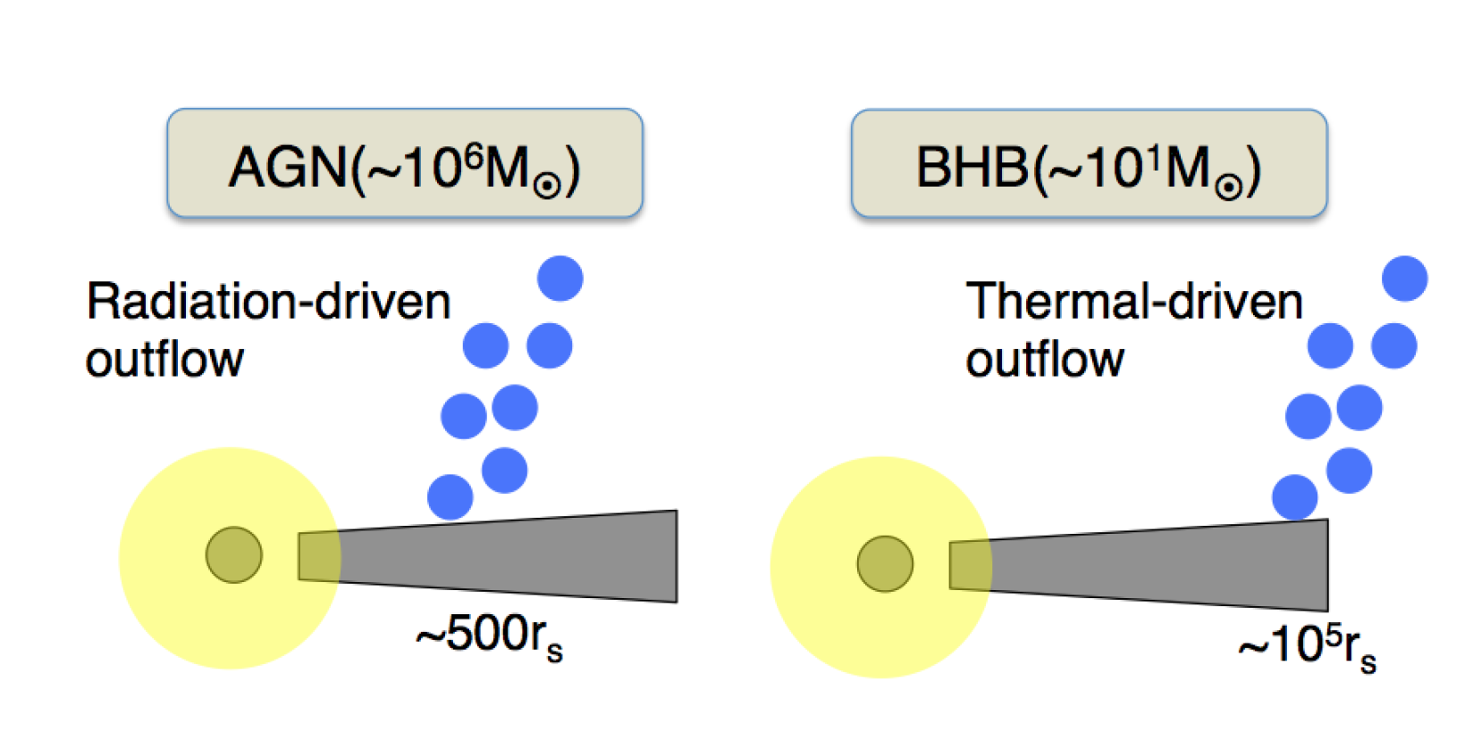
Difference of the outflow mechanisms
Mizumoto et al. (2015)
UV dominated
X-ray dominated
Location (timescale) of the outflow is NOT normalized by BH mass
→ (Presumably) Origin of difference of the broad iron line variation

Slide 70
Contents
Introduction
Variable Double Partial Covering (VDPC) Model
Application to Observations
Structure around the AGN
Comparison with BHBs
Conclusion

Slide 71
Contents
Introduction
Variable Double Partial Covering (VDPC) Model
Application to Observations
Structure around the AGN
Comparison with BHBs
Conclusion

Slide 72
5. Conclusion
We observed X-ray energy spectra of Seyfert galaxies exhibiting seemingly broad iron line structure.
Partial covering phenomena are observed, which indicates that the X-ray emission region is extended (~>10 Rs), thus the relativistic disk reflection (~1Rs) is unlikely.
Observed spectral variation can be explained by the Variable Double Partial Covering Model, where the extended central X-ray source is partially covered by absorbers with internal structure.
The seeming broad iron K- and L-line structures are respectively explained by the cold/thick core and the hot/thin layer of the absorbers
Most spectral variation within ~a day is explained by change of the partial covering fraction.
The partial covering model also explains the broad iron line feature observed in the BH binary GRS1915+105

