Slide 1
Microphysics and X-ray Spectra of AGN Outflows
T. Kallman NASA/GSFC
Line emission efficiency across the spectrum
Thermal stability

Slide 2
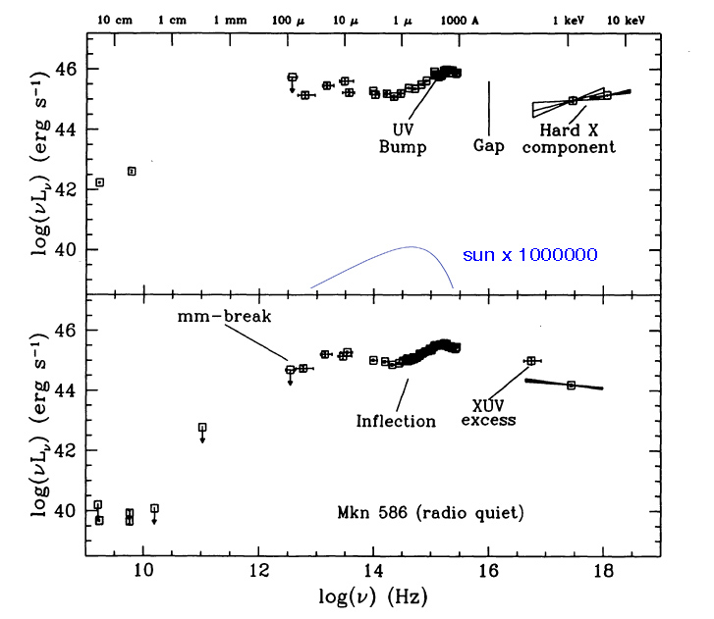
The broad-band spectrum of active galaxies
~flat over 6-8 decades
Very different from stars
Most are strong X-ray sources

Slide 3
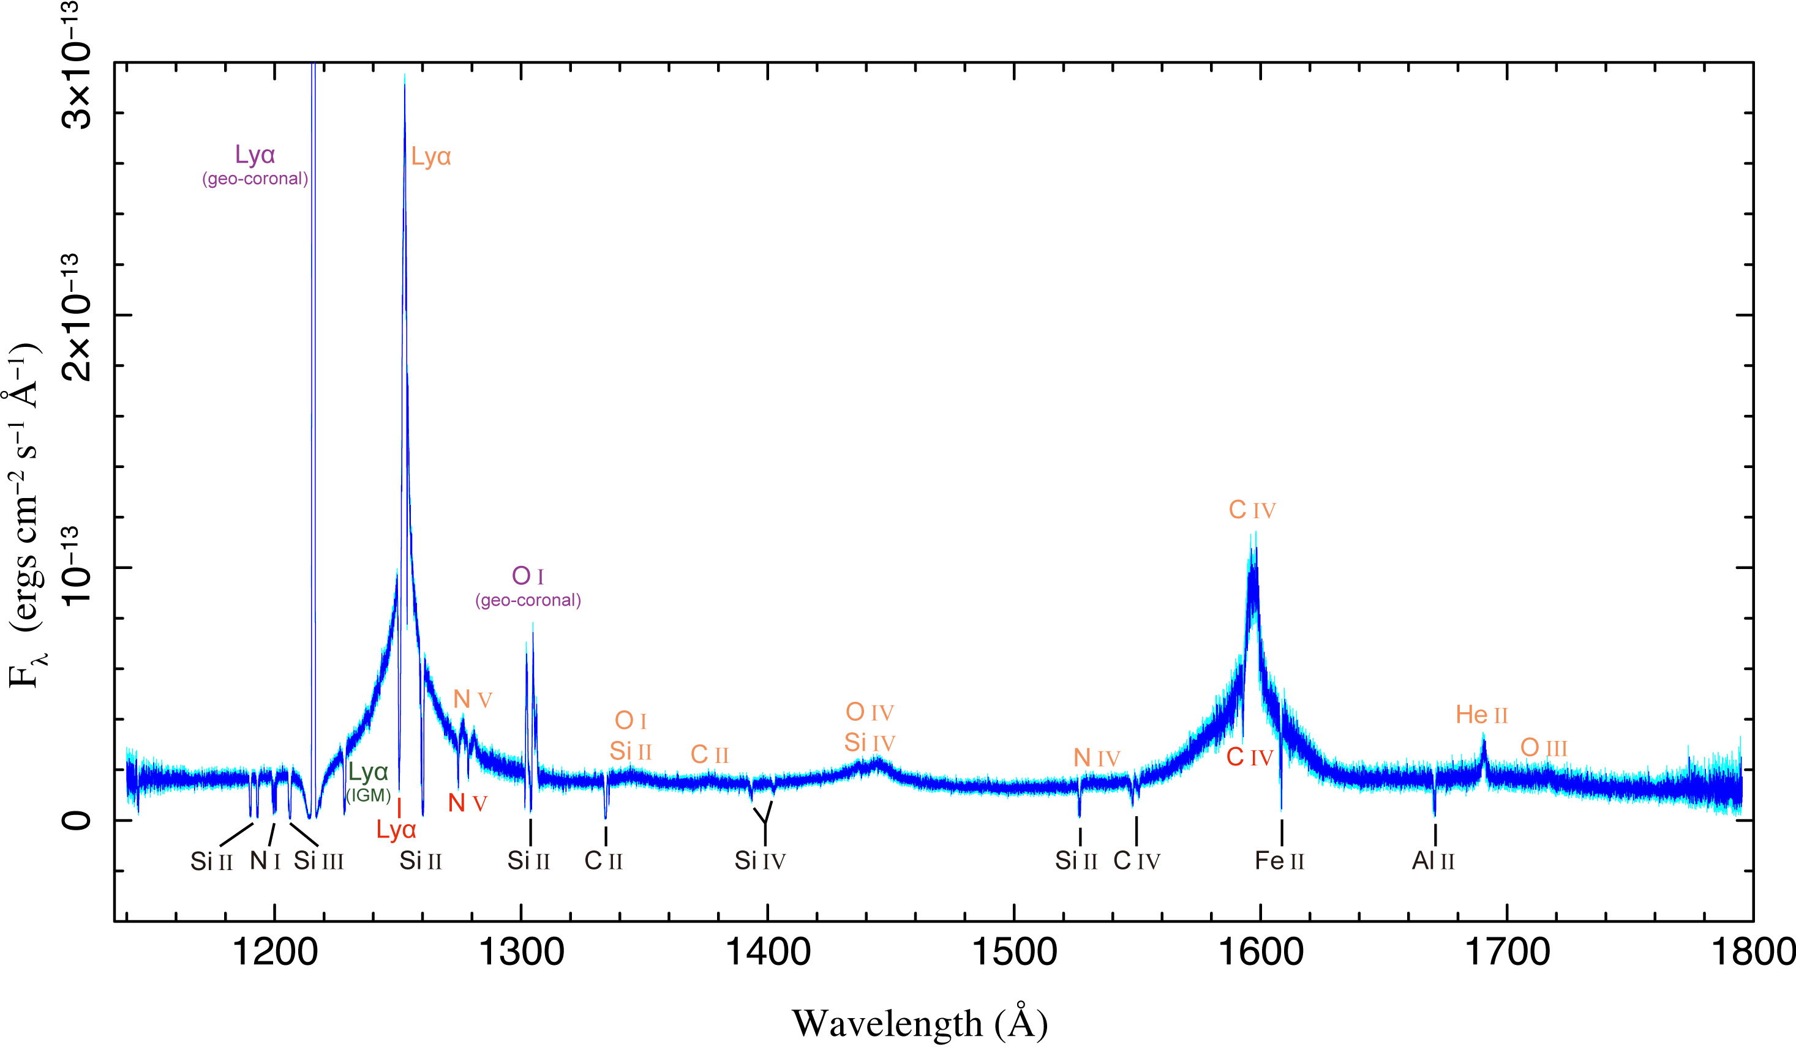
HST/COS spectrum of Mkn 290
UV/optical spectra are dominated by ‘broad’ and ‘narrow’ emission lines
Line profiles are very smooth
Lines from diverse ionization stages have very similar profiles
Warm absorber lines and foreground lines are narrow, superimposed on emission
(Zhang et al. 2015)

Slide 4
Warm absorbers can show strong variability
ngc 5548
(Kaastra et al. 2014)

Slide 5
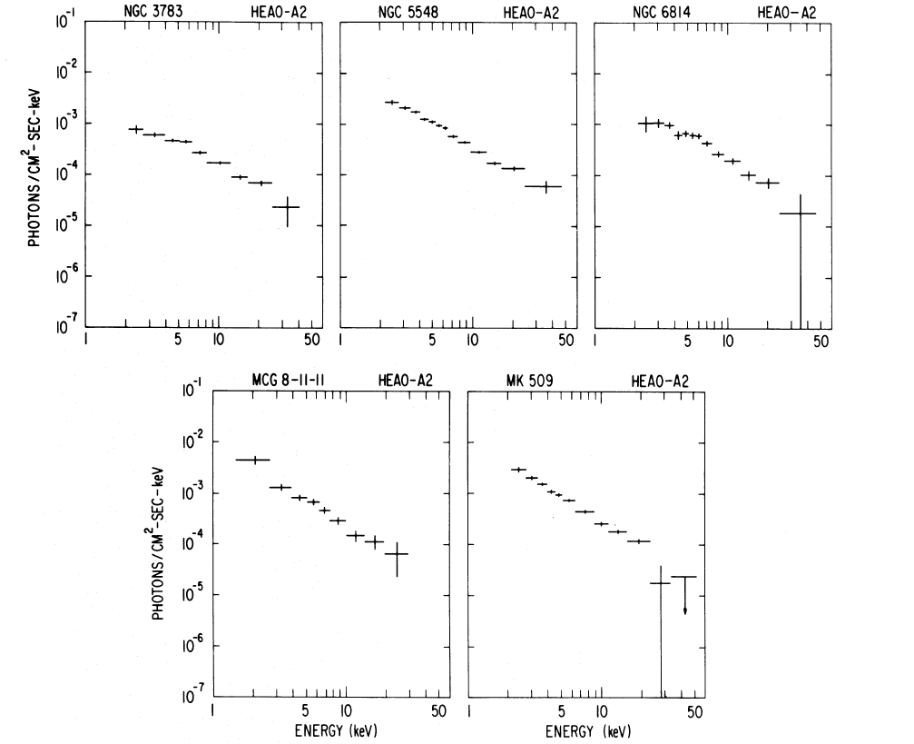
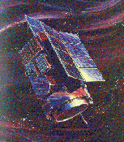
X-ray continuum spectra of AGN show a ~power law shape
HEAO-1 spectra
In the 2-10 keV band, remarkable uniformity of X-ray continuum spectra
(Mushotzky et al., 1978)

Slide 6
Predicted AGN X-ray spectrum
Before Chandra and XMM it was assumed that X-ray gas would resemble broad line clouds
X-rays would show emission lines due to extended spherical gas with with density less than broad line clouds
(Netzer 1996)

Slide 7
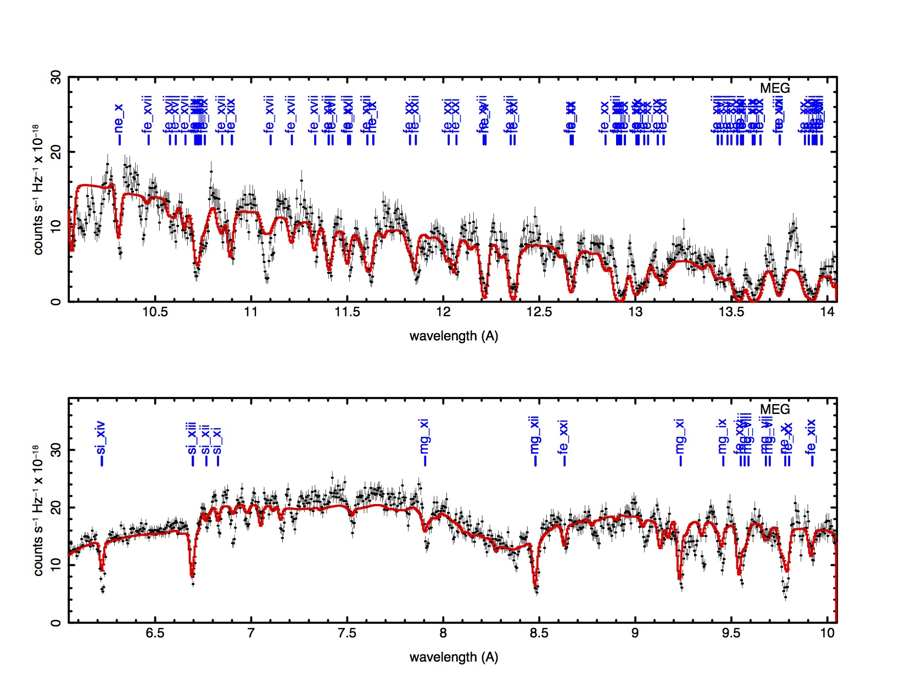
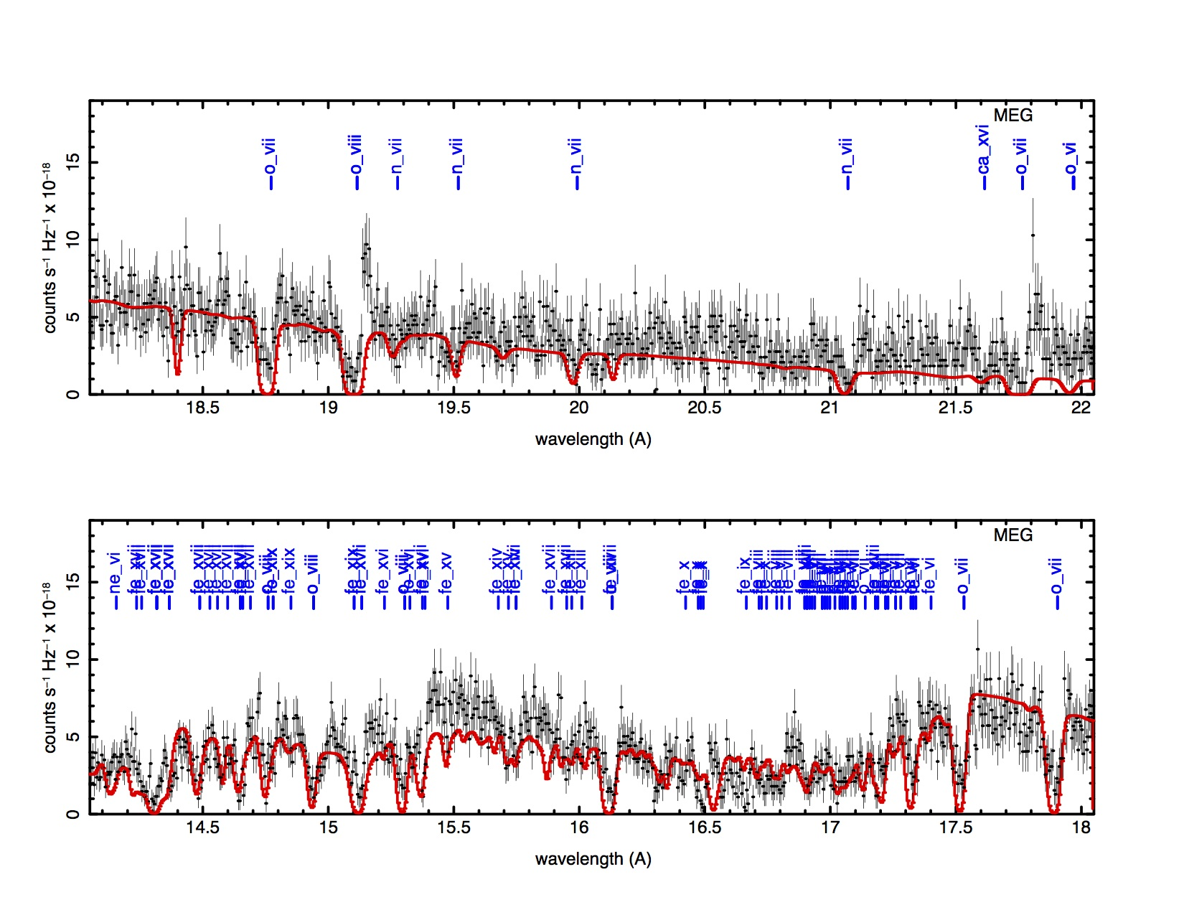
Canonical warm absorber Spectrum shows absorption from a wide range of ions
NGC3783

Slide 8
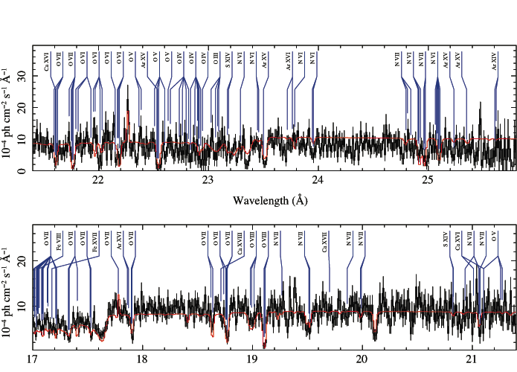
Warm absorbers exhibit gas over a wide range of ionization states
Essentially all ion stages of oxygen are observed in HETG spectrum of Mcg-6-30-15

Slide 9
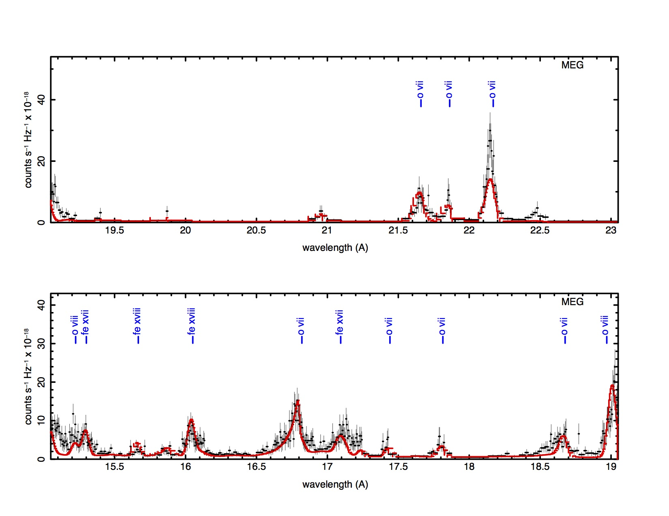
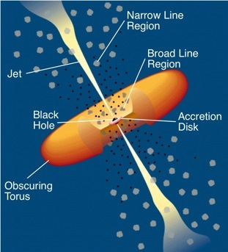
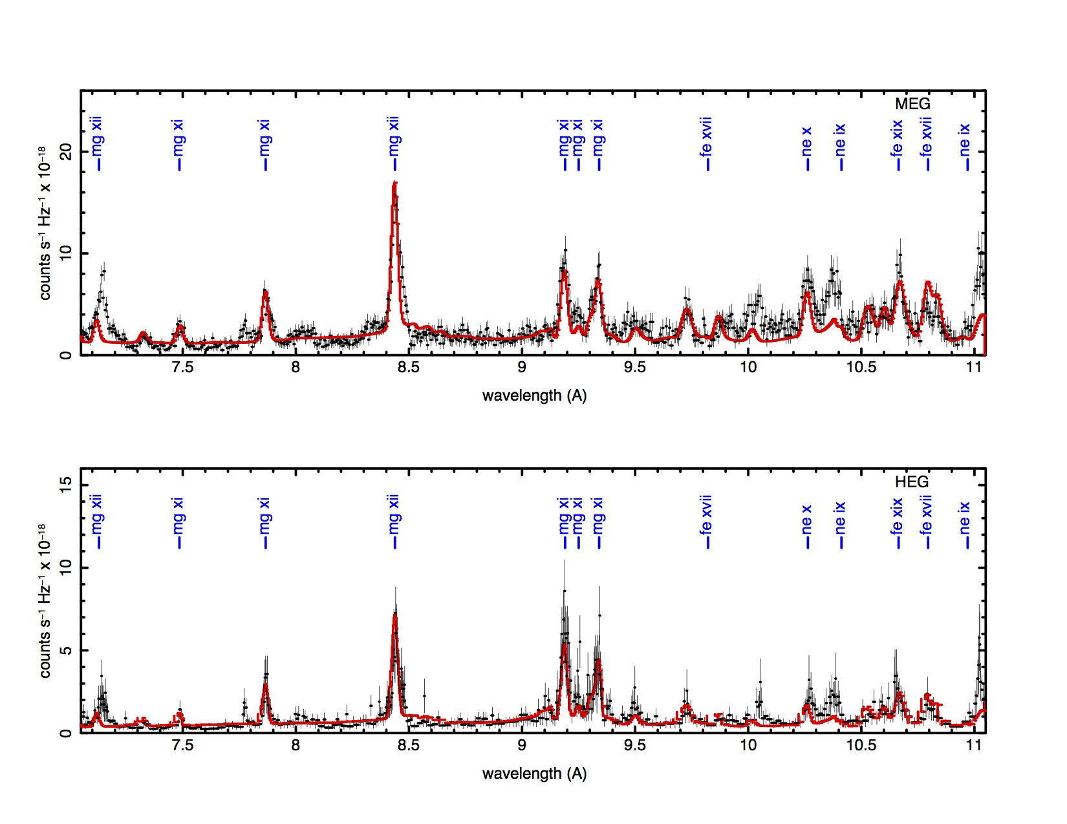
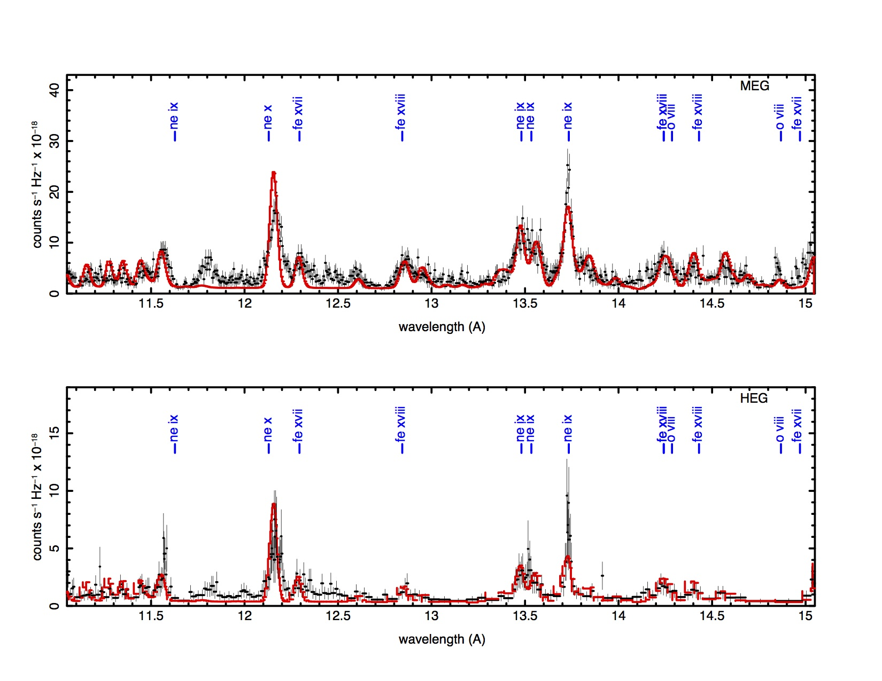
Seyfert 2 galaxies show emission associated with narrow line region
NGC1068
(Bauer et al. 2015)

Slide 10
UFOs have v~0.1c
PG1211+143
If due to Fe
Features are variable in time
~ 1/3 of all warm absorber sources
(Tombesi et al. 2010)

Slide 11
Relativistic iron line is observed from many AGN
(Brenneman et al. 2011)

Slide 12
Line properties hint at relative importance of various phases of gas
The importance of a line to the global energetics depends on the quantity
Approximate values for these quantities for various lines show which gas is more important to reprocessing the continuum
line | E (keV) | Δ v (km/s) | Δ E (keV) | Δ E/E | EW (keV) | F_{E,line}/F_{E,cont} | EW/E
L α (blr) | 0.0102 | 10000 | 3.40E-04 | 0.034 | 1.70E-03 | 5 | 0.17
L α (nlr) | 0.0102 | 1000 | 0.034 | 0.0033 | 0.031 | 15 | 3.04
o viii (wabs) | 0.65 | 1000 | 0.022 | 0.0033 | 0.022 | 0 | 0.033
Fe kα (narrow) | 6.4 | 1000 | 0.21 | 0.0033 | 0.1 | 1.5 | 0.012
Fe kα (relativistic) | 6.4 | 30000 | 0.6 | 0.1 | 0.1 | 1.2 | 0.015
Fe kα (Sy2) | 6.6 | 1000 | 0.21 | 0.0033 | 2 | 10 | 0.3
ufo Fe XXVI | 7 | 30000 | 0.7 | 0.1 | 0.7 | 0 | 0.1

Slide 13
Does this make sense? Think about how light from the black hole is reprocessed
The luminosity of a line can be written
And we can use the behavior of photoionized gases. Temperature and ionization balance depends on

Slide 14
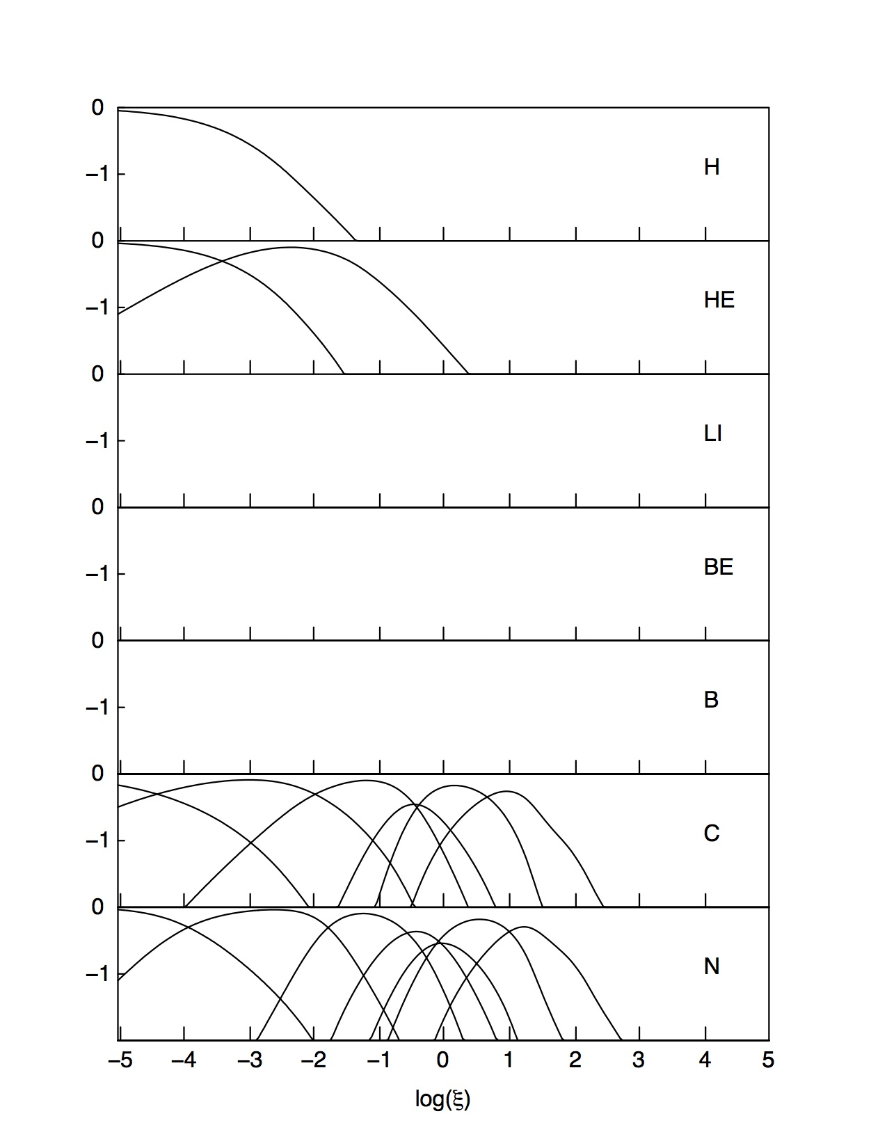
Typical ionization balance for photoionized model, ionized by a power law with Γ=2
The mean charge increases as Z~ξ^{1/3}
Log(fractional abundance)

Slide 15
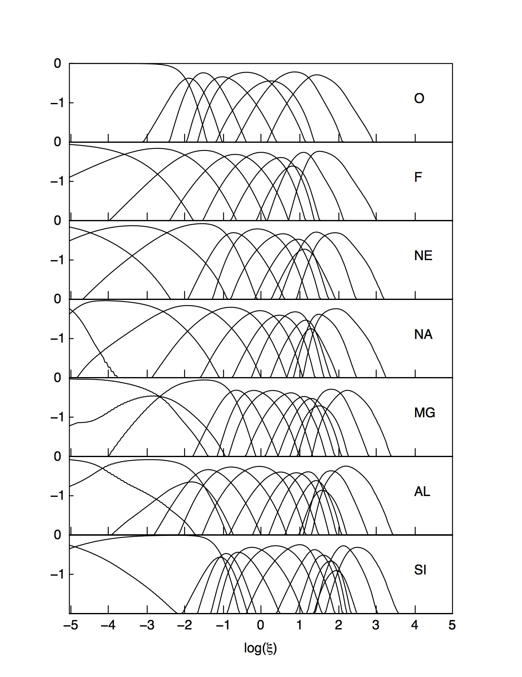
Typical ionization balance for photoionized model, ionized by a power law with Γ=2
The mean charge increases as Z~ξ^{1/3}
Log(fractional abundance)

Slide 16
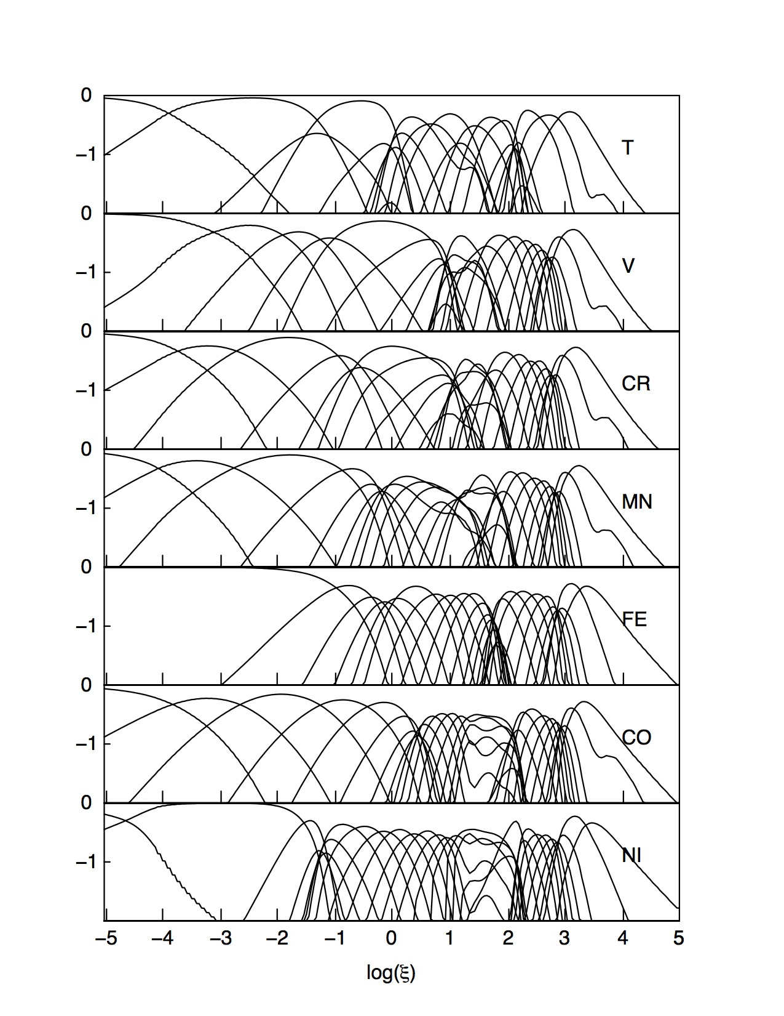
Typical ionization balance for photoionized model, ionized by a power law with Γ=2
The mean charge increases as Z~ξ ^{1/3}
Log(fractional abundance)

Slide 17
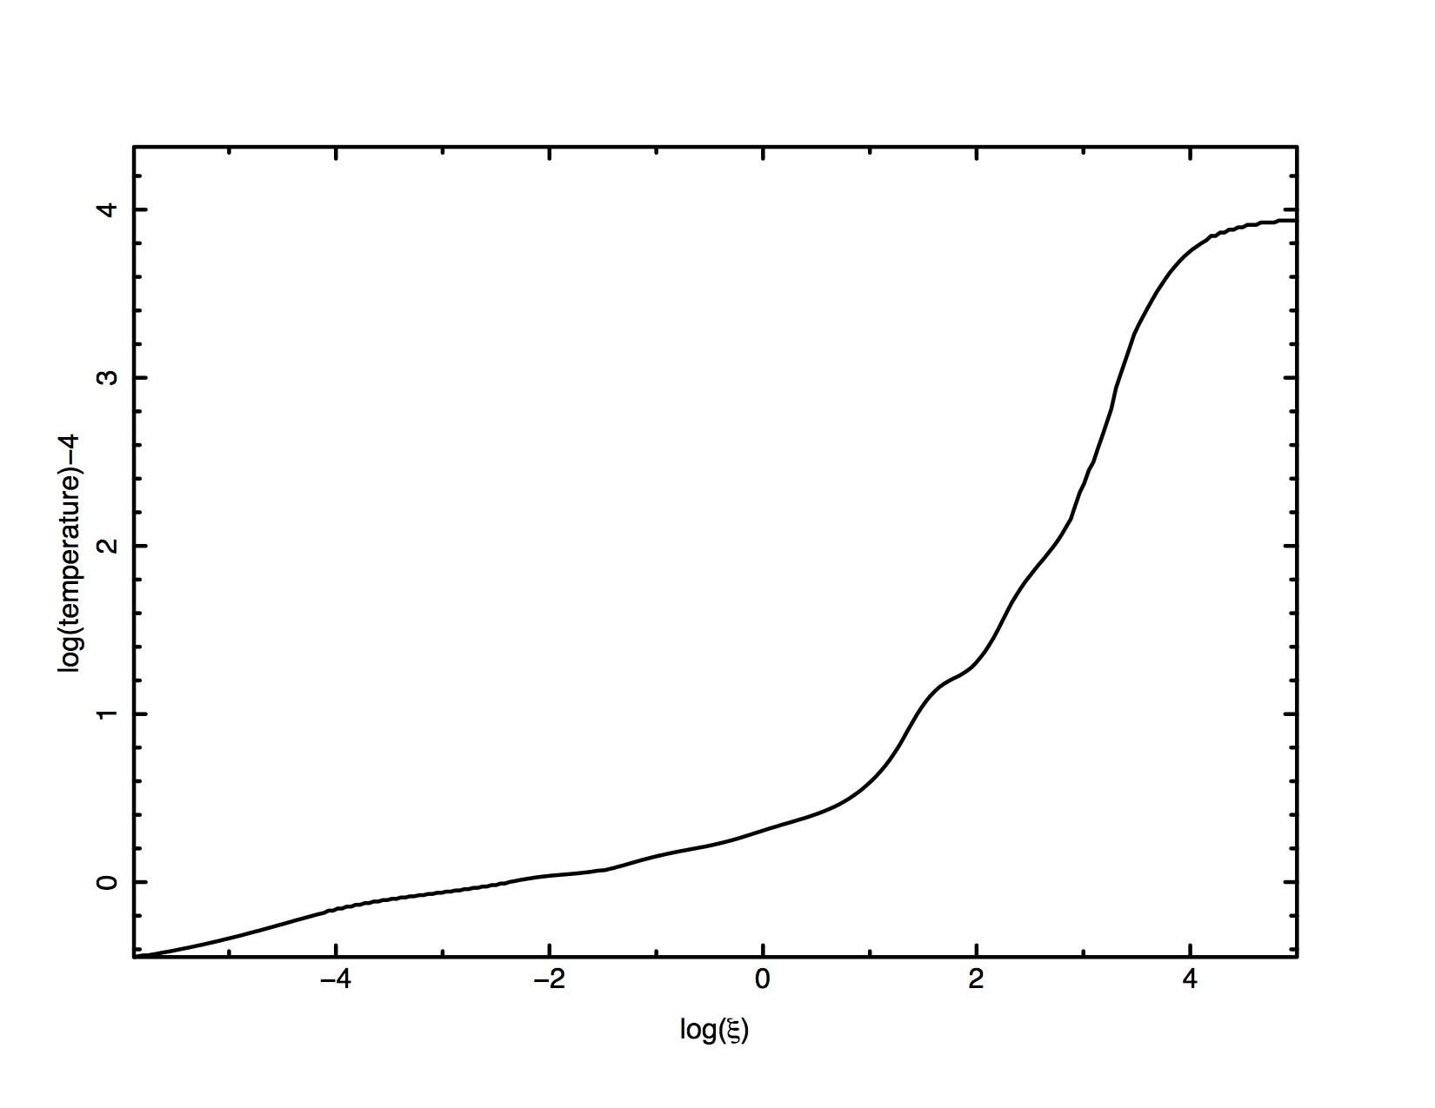
Temperature structure of photoionized model with Γ=2 SED incident continuum
The temperature increases as T~ξ

Slide 18
Line reprocessing efficiency depends inversely on the line energy
Scaling of mass/charge of dominant line-emitting species
Scaling of typical line energy with ξ:
Scaling of thermal speed:
→ efficiency of reprocessing vs line energy ε
Assuming all the gas available is used, covering factors are the same …

Slide 19
How does this scaling compare with what we see?
Surprising?
Iron lines, warm absorber, narrow lines approximately agree
Seyfert 2 line is stronger due to covering fraction >1
UFO lines are much stronger than expected

Slide 20
Now consider in more detail: why are some gas conditions seen, others not
Suggestive of thermal instability
Due to strong temperature dependence of cooling function vs. T
  When (dΛ/dT)_{P,n}>0 temperature can be multi-valued (Krolik McKee and Tarter 1981, Buff and McCray 1974)
  Depends on assumption of thermal (and ionization) equilibrium
  Instability is (much) stronger at constant pressure
  Constant density gas with AGN SED is stable
If so, depends on interesting things:
  Shape of ionizing spectrum (SED) from IR → γ
  Atomic rates
  Abundances
  Density
Suggests possible diagnostic use

Slide 21
Canonical warm absorber Spectrum shows absorption from a wide range of ions
NGC3783

Slide 22
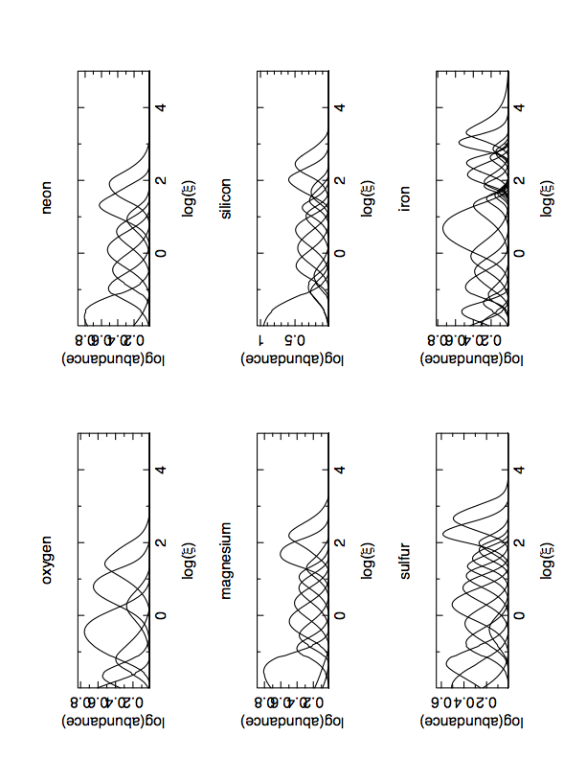
But some warm absorbers favor certain ionization parameters, avoid others
Ionization balance with new DR rates
Ionization balance; new DR rates
Avoided zone

Slide 23
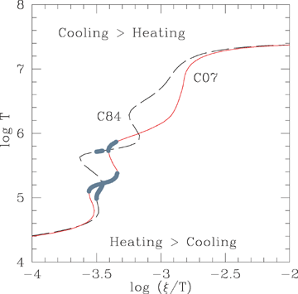
Thermal instability makes the temperature multi-valued for isobaric gas
May answer the question:Why is the ionization distribution bimodal?
But this depends on the assumption that thermal and pressure equilibrium are satisfied
(Chakravorty et al., 2008)

Slide 24
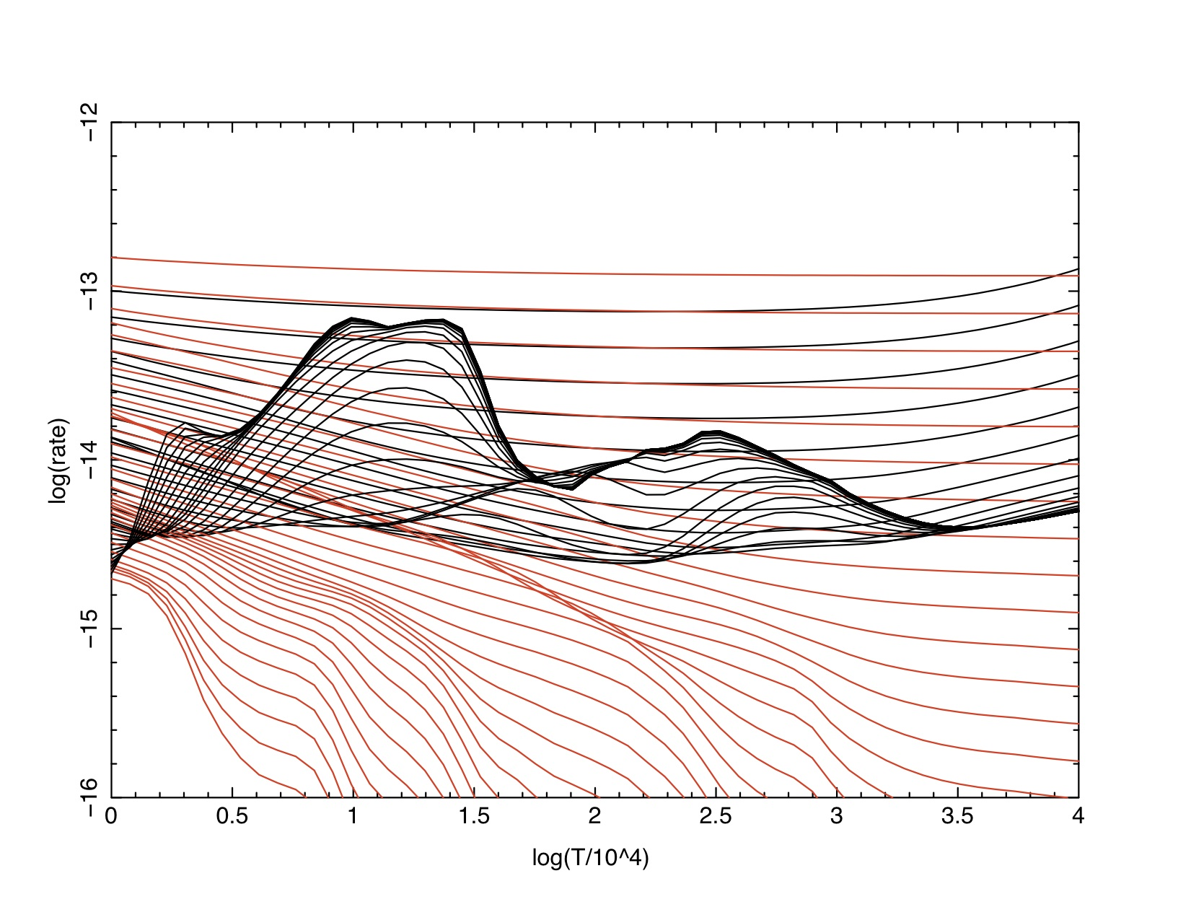
The origin of the thermal instability: heating and cooling rates vs. T and ξ
Curves correspond to different ionization parameters
Red=heating rate (erg/s/cm³ )
black=cooling rate (erg/s/cm³)

Slide 25
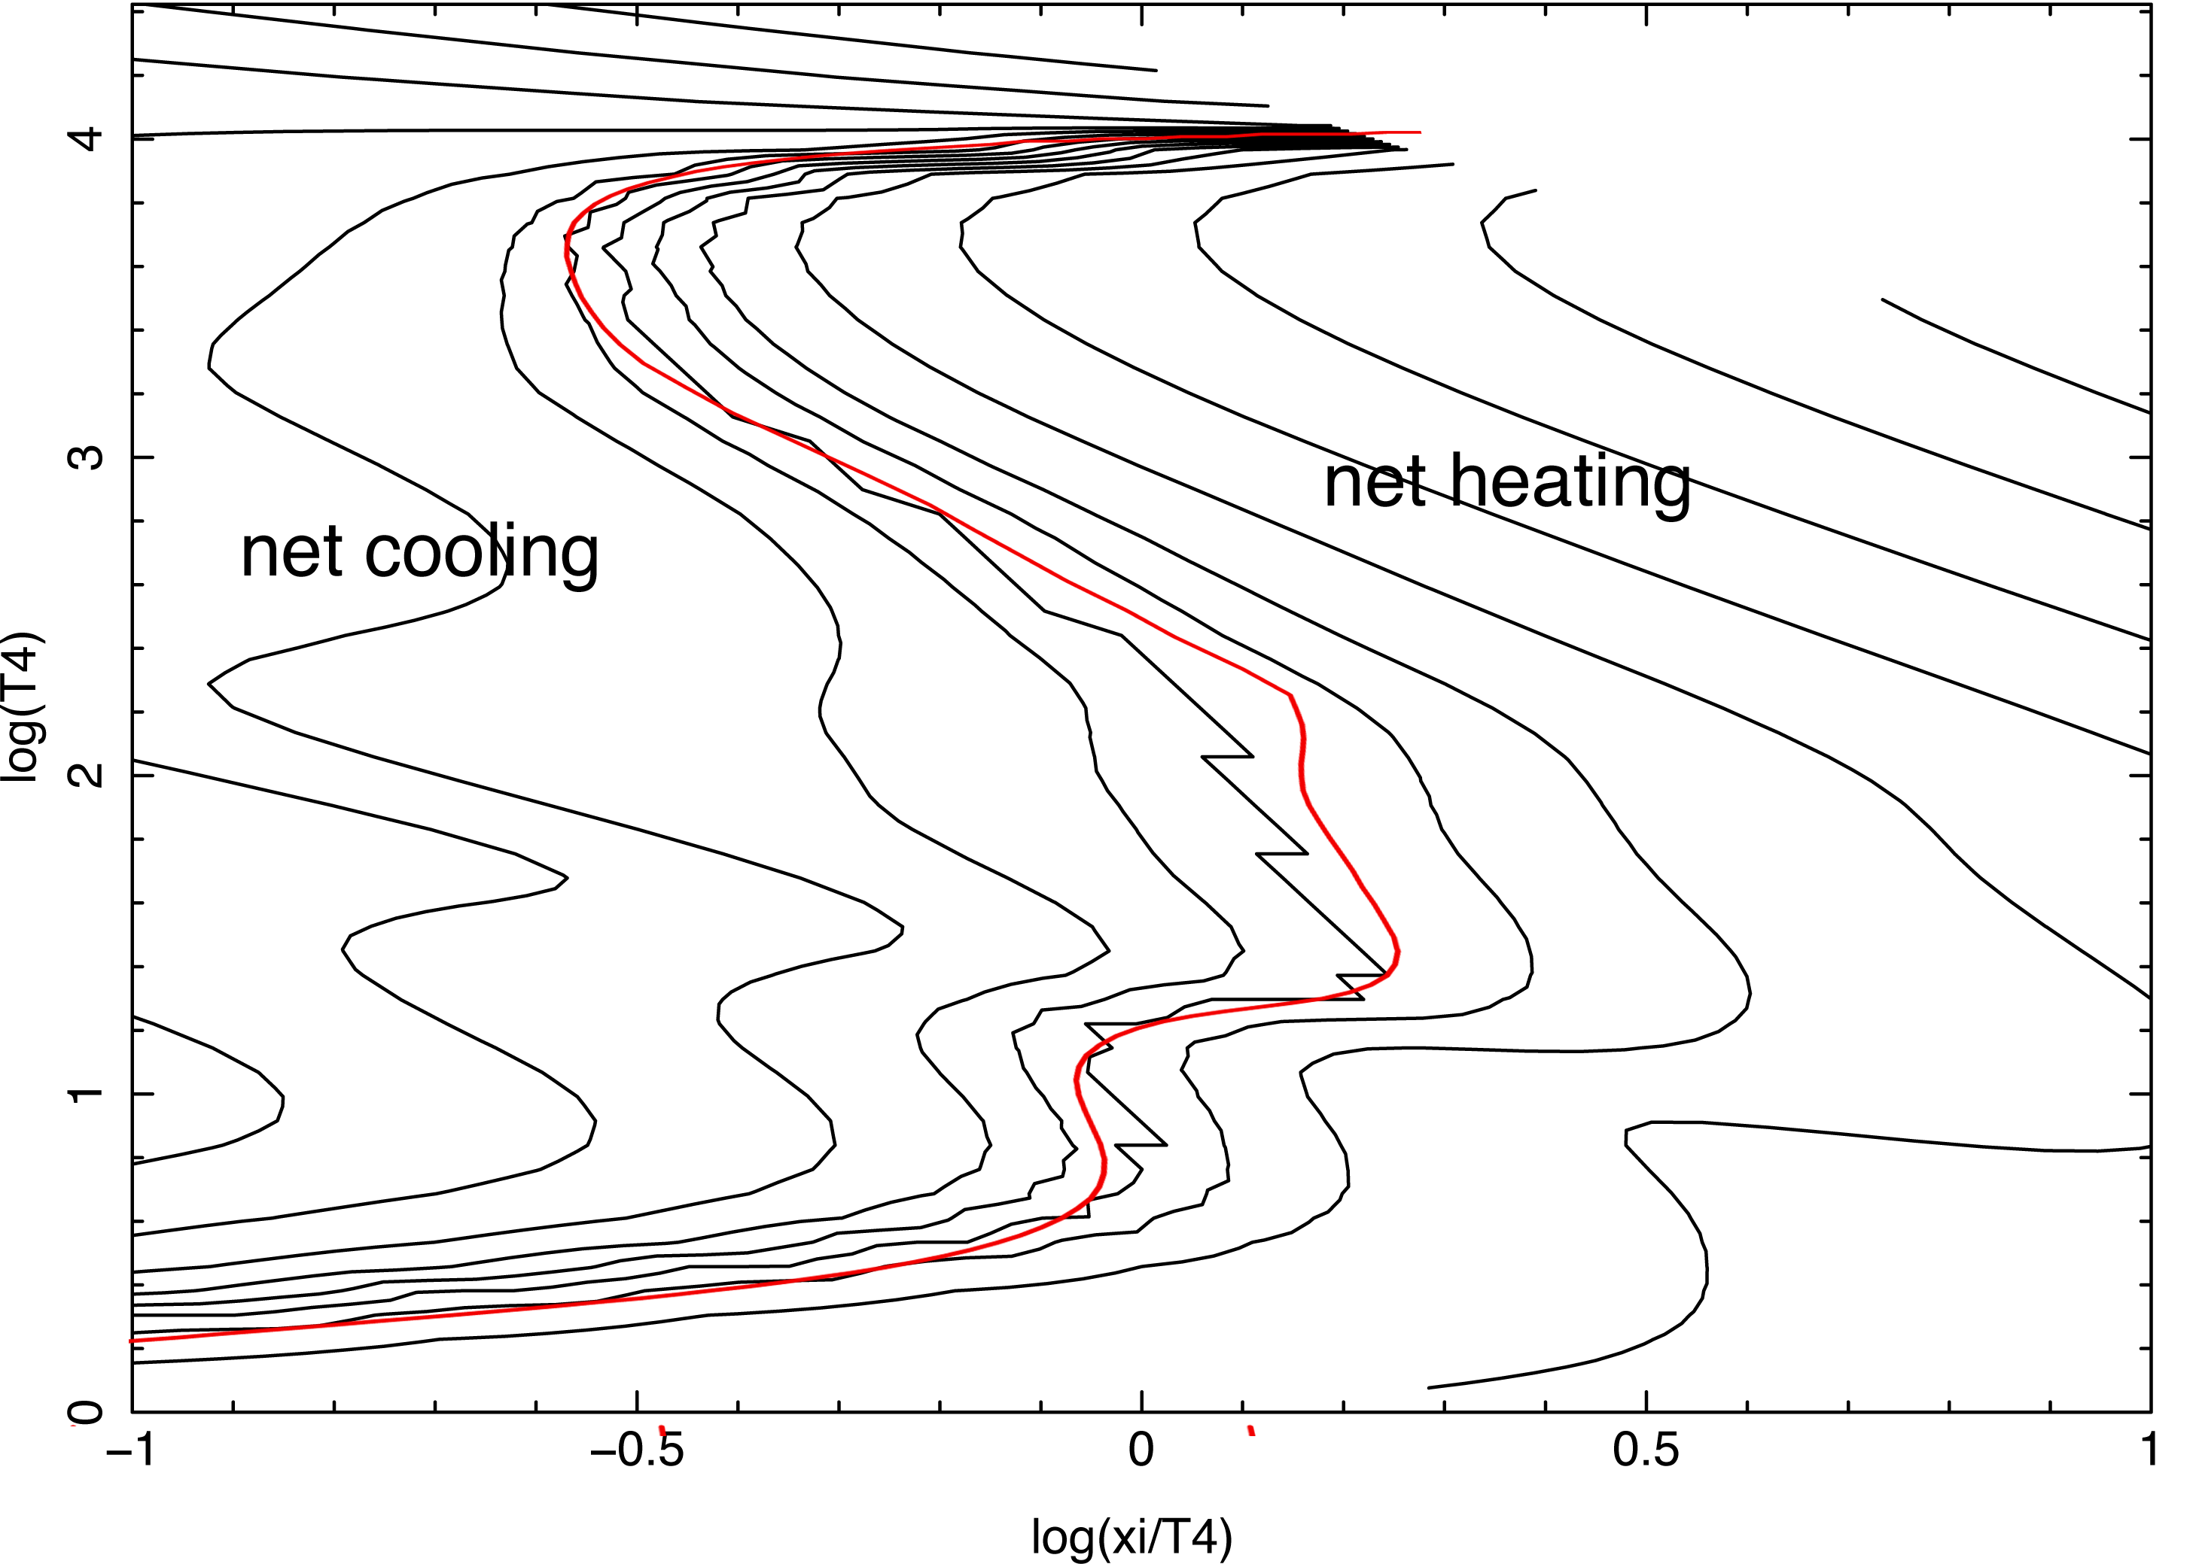
Contours of net cooling vs. T and ξ/T

Slide 26
Is the two phase picture plausible? Consider physical conditions in warm absorbers:
Outflow speeds ~ turbulent speeds
~10²-10³ km/s
Ionization parameter log(ξ)~2, 0.5
Bounds on position from variability are conflicting
Equilibrium arguments suggest R~1pc
density:

Slide 27
Heating and cooling rates
Heating has contributions from Compton, photoionization:
Cooling has contributions from bremsstrahlung, and from atomic bound-bound and bound-free collisional processes

Slide 28
Then we can estimate timescales in a warm absorber flow:
For temperatures near 10⁵K,
ionization parameters near log(ξ)=2
For these parameters, fast cooling requires n>10⁵ cm⁻³
This is dicey, depends on conditions
t _{s} > t _{flow} unless T> 10⁶K .. Alfven waves could help..

Slide 29
Now test this for a more realistic model of the warm absorber
2.5dimensional hydro calculation of the evaporation from torus
Torus is heated by Γ=2 power law from the black hole
Warm absorber is formed as gas is evaporated and flows out (radiative driving is included)
Thermodynamics of X-ray heating, radiative cooling is included
Pure hydro, no mhd
Synthetic spectrum is also calculated

Slide 30
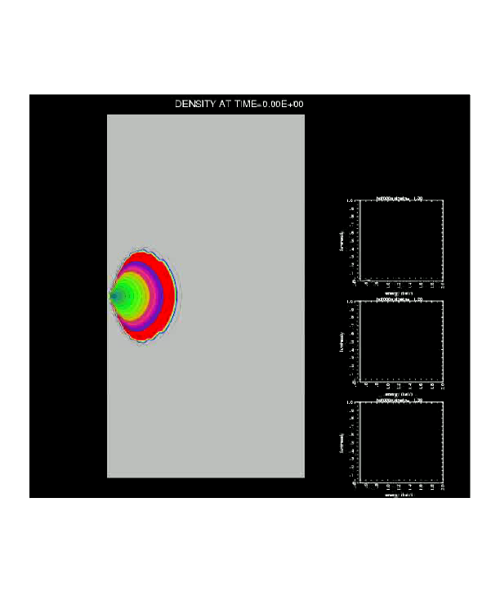
Hydrodynamic calculation of evaporation from cold torus at 1 pc
X-rays from black hole
observer
(Dorodnitsyn and K. 2008)

Slide 31
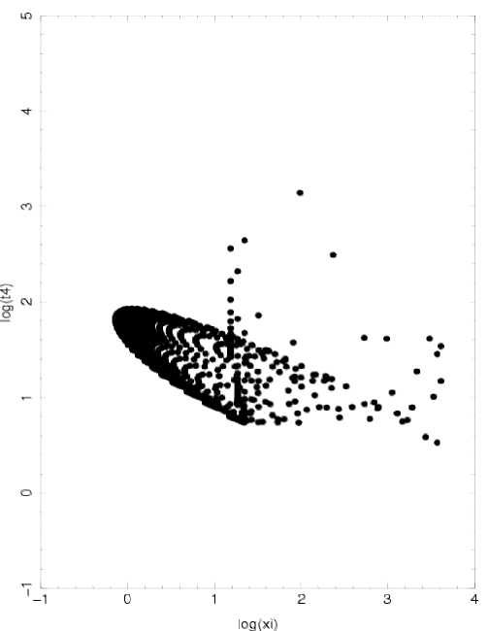
What happens to gas in the T-ξ/T plane in such a model..
Log(ξ/T)

Slide 32
Thermal properties and appearance of AGN gas flows are affected by
  Non-thermal-equilibrium effects
  Adiabatic cooling
  Details of dynamics: pressure distribution matters
  Simple models provide a very approximate guide for where the gas ends up
  Simple models overestimate the ionization parameter
  We should not be surprised to see gas in ‘unstable’ regions
  Appearance varies on flow timescale → the ‘same’ model may look different when viewed in many different objects

Slide 33
Warm absorber questions
General properties: v~10⁸ cm s⁻¹, N~10²¹ cm⁻²
Location is uncertain; virial flow → R=2GM/v²~0.01 pc M₆ v₈²
M=Ω R v N m_{H}=6 x 10²⁴ gm s⁻¹ R_{pc} v₈ N₂₁ Ω/4π
Compare with M_{accretion}= L /ηc² ~ 1 x 10²⁴ L₄₄ η_{0.1}
What is Ω? How can it be big and small at the same time?
What is R? Where does warm absorber originate?
  Virial R is near location of torus … evaporative flow?
Emission vs absorption → correspondence but it’s complicated by nlr
Ufos? What’s going on?
Ionization distribution: continuous or not?
Variability → size constraints

Slide 34
Big questions
What are dynamics etc. of broad line gas?
What is mdot and covering fraction of warm absorber?
What are ufos and how much outflow do they represent?
Do we really understand disk reflection?

